Slide 1
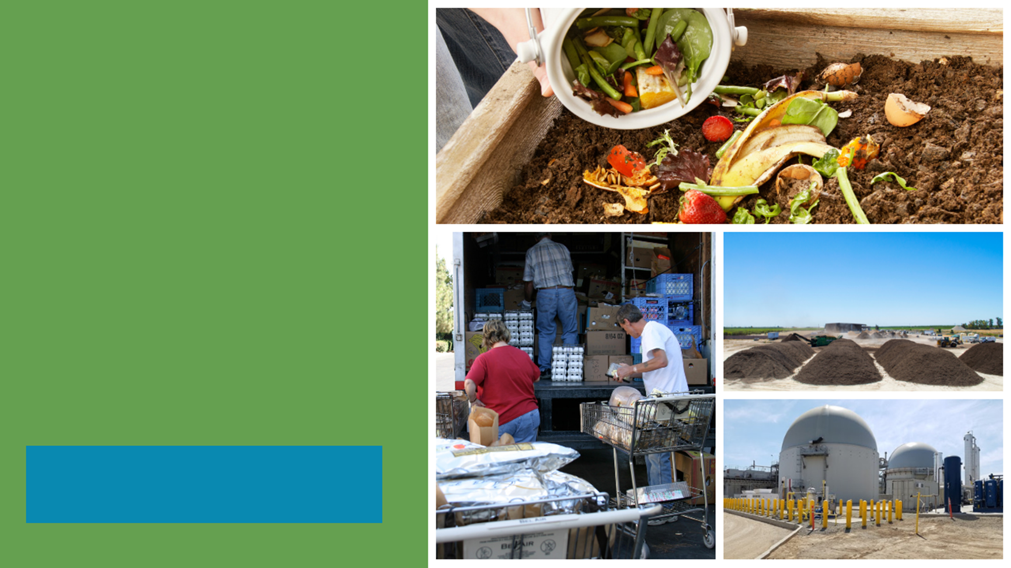
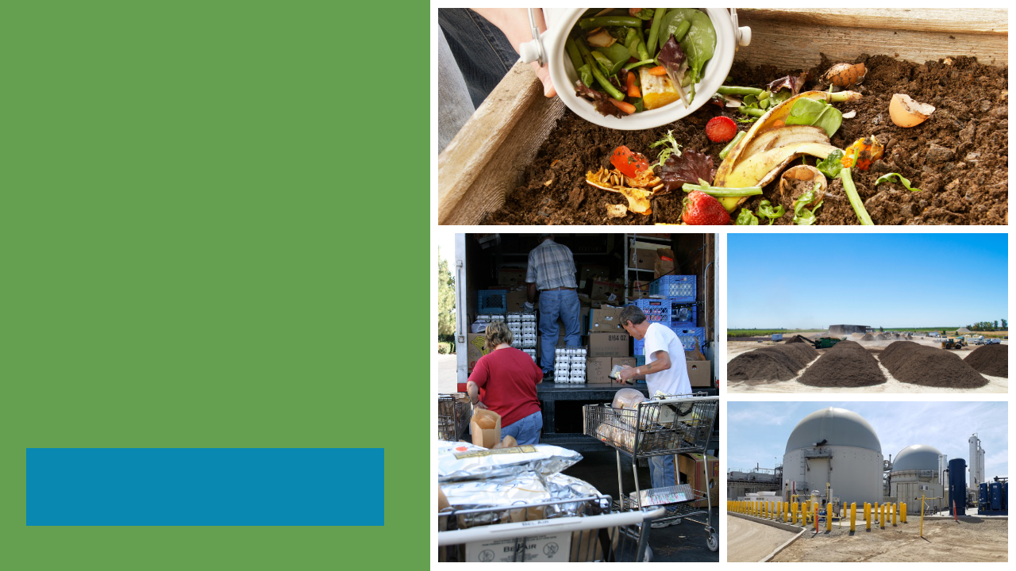

SB 1383
Reducing Short-Lived Climate Pollutants in California
An Overview of SB 1383’s Organic Waste Reduction Requirements & Ordinance 759
Presented by: Elizabeth Rodriguez
December 8, 2021
Notes:
Good evening Honorable Mayor, Council, Audience and Staff,
The presentation tonight will be an overview of SB 1383’s Organic Waste Reduction Regulations, Jurisdiction Requirements & Ordinance 759, which is based on these regulations.

Slide 2
HISTORY OF SOLID WASTE LAWS
ASSEMBLY BILL 939 – CALIFORNIA INTEGRATED WASTE MANAGEMENT ACT OF 1989
1989
ASSEMBLY BILL 341 – MANDATORY COMMERCIAL RECYCLING
2011
ASSEMBLY BILL 1826 – MANDATORY COMMERCIAL ORGANICS RECYCLING
2014
SENATE BILL 1383 – SHORT-LIVED CLIMATE POLLUTANT REDUCTION ACT OF 2016
2016
Notes:
In 1989, AB 939 or the California Integrated Waste Management Act of 1989 was enacted and requires cities and counties to reduce, reuse, and recycle (including composting) solid waste generated in their jurisdictions to the maximum extent feasible before any incineration or landfill disposal of waste. This law was passed to ensure that jurisdictions were conserving water, energy, and other natural resources, and overall, protecting the environment.
Fast forward to 2011, and Assembly Bill 341 was created to place requirements on businesses and multi-family property owners that generate a specified amount of solid waste to arrange for recycling services and requires the City to implement a mandatory commercial recycling program.
Next came, Assembly Bill 1826 of 2014, which requires businesses and multi-family property owners that generate a specified amount of solid waste, recycling, and organic waste per week to arrange for recycling services for that waste, requires cities to implement a recycling program to divert organic waste from businesses subject to the law, and requires cities to implement a mandatory commercial organics recycling program.
Finally, SB 1383, the Short-lived Climate Pollutant Reduction Act of 2016, requires the California Department of Resources Recycling and Recovery (“CalRecycle”) to develop regulations to reduce organics in landfills as a source of methane. As adopted by CalRecycle, these SB 1383 regulations (“SB 1383 Regulations”) place requirements on multiple entities including the City of Irwindale, residential households, commercial businesses and business owners, commercial edible food generators, haulers, self-haulers, food recovery organizations, and food recovery services to support achievement of statewide organic waste disposal reduction targets.
SB 1383 is the most significant waste reduction mandate to be adopted in California in the last 30 years.

Slide 3
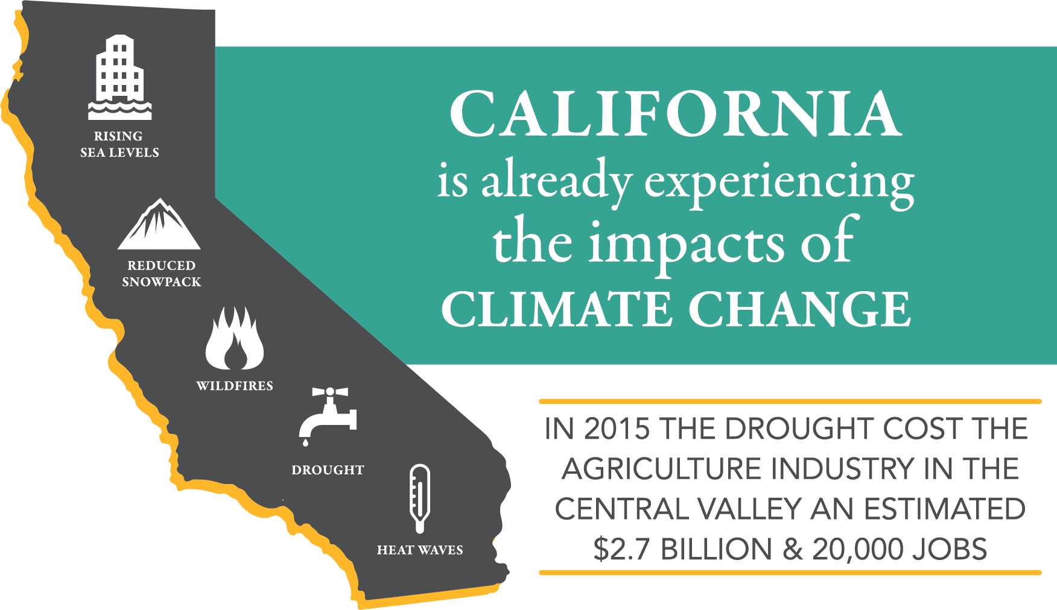
WHY SB 1383?
ORGANIC WASTE = LARGEST WASTE STREAM
2018: 24 MILLION TONS OF ORGANIC WASTE DISPOSED OF IN CALIFORNIA
CLIMATE CHANGE
CALIFORNIA IS EXPERIENCING
6 MILLION TONS
OF FOOD WASTE IS
THROWN AWAY
1 IN 5 CALIFORNIANS
ARE FOOD INSECURE
Notes:
Why SB 1383? The state enacted SB 1383, to reduce global warming gasses like methane, which are the most potent and are “short-lived”. Landfills are responsible for 21% of the state’s methane emissions & are the third largest producer of methane in the state. Methane is 84 times more potent than Carbon Dioxide over a 20-year horizon. Landfilling organic waste is a significant source of local air quality pollutants, which has an immediate negative impact on the air we breathe and it can cause respiratory issues & hospitalizations. Diverting organic waste to recycling can significantly reduce these local air quality emissions & associated negative impacts.
We are starting to see the effects of climate change in all cities & counties across California. The effects of climate change are extremely noticeable with coastal erosion due to rising sea levels. Longer droughts & warmer temperatures are drying forest & contributing to the ever-increasing number of wildfires in California, which also impacts air quality; creating reduced snowpack & available drinking water; & creating heat waves. The costs are in the billions from fighting wildfires, removing debris, rebuilding homes, & implementing strategies & laws to find drinkable water & edible food. The financial & public health impacts are already here as a result of climate change.
When talking about organic waste as part of SB 1383, we mean materials such as green waste, wood waste, food waste, & also fibers, such as paper & cardboard. Take a look at the graph to the right, Organic waste comprises over half, or 52% of our waste stream. According to CalRecycle’s waste characterization study in 2018, 24 million tons of organic waste was disposed of in California and $6 million tons of food waste is thrown away each year. This is very important information because 1 in 5 children go hungry every night in California. For every 2 ½ tons of food rescued is equivalent of taking 1 car off the road for a year. Recovering and redirecting one ton of edible food could provide more than 1600 meals to food insecure individuals.

Slide 4
SB 1383 Requirements
2020
50% Reduction in Landfilled Organic Waste
(11.5 Million Tons of Organic Waste Disposal Allowed)
2022
Regulations Take Effect
REGULATIONS REQUIRE LOCAL GOVERNMENTS TO TAKE ENFORCEMENT
2024
75 % Reduction in Landfilled Organic Waste (5.7 Million Tons of Organic Waste Disposal Allowed)
20 % of currently disposed edible food must be recovered for human consumption
2025
Notes:
SB 1383 establishes aggressive organic waste reduction targets and basically builds upon AB 1826, the Mandatory Commercial Organics Recycling law. The first established target requires Californians to reduce organic waste disposal by 50% by 2020 and allows for only 11.5 million tons of organic waste to be disposed of in a landfill, which is 50% of the 23 million tons of organic waste that was disposed of in 2014 and based on CalRecycle’s 2014 Waste Characterization Study measurements.
Regulations Take Effect on Jan. 1, 2022, which means that Jurisdictions must have their programs in place on January 1, 2022. This also means that CalRecycle will start meeting with jurisdictions to ensure they are in compliance with SB 1383. Those cities that are not in compliance will receive a Notice of Violation or a Corrective Action Plan depending on the extent of noncompliance.
In 2024, Jurisdictions will be required to take enforcement action against noncompliant entities such as residents, businesses, property owners, food generators and food recovery organizations.
And in 2025, the second established target requires 75% reduced organic waste disposal, which allows for only 5.7 million tons of statewide organic waste disposal. Additionally, as a part of the disposal reduction targets the Legislature directed CalRecycle to increase edible food recovery for human consumption by 20 percent by 2025. The food recovery goal is certainly very unique. These disposal reductions will reduce at least 4 million metric tons of greenhouse gas emissions annually by 2030.
(Note: The Office of Administrative Law approved the regulations on November 3, 2020.)

Slide 5








Jurisdiction Responsibilities
Provide Organics Collection Services to All Residents and Businesses
Conduct Education and Outreach to Community
Secure Access to Recycling and Edible Food Recovery Capacity
Establish Edible Food Recovery Program
Procure Recyclable and Recovered Organic Products
Monitor Compliance
and Conduct
Enforcement
Notes:
SB 1383 requires local governments to provide the following programs:
1. Provide mandatory organic waste curbside collection to all residents and businesses. The City of Irwindale currently has a mandatory organic waste curbside collection for all businesses and is currently working with Athens to provide a curbside collection for all residents. Organic Waste, includes green waste, wood waste, food waste, manure, and fibers to name a few. Containers must have specific colors such as black, green & blue. Containers must be labeled and monitored for contamination.
2. Establish an edible food recovery program that recovers edible food from the waste stream for Tier 1 and Tier 2 food generators. The City of Irwindale has partnered with the San Gabriel Valley Council of Governments to provide an edible food recovery program.
3. Conduct outreach and education to all affected parties, including generators, haulers, facilities, edible food recovery organizations/services, and city departments. The City of Irwindale is working with the COG and Athens to provide outreach and education to all parties.
4.Procure recycled organic waste products like compost, mulch, and renewable natural gas (RNG) and recycled content paper and paper products. At its November 10, 2021 meeting, City Council adopted the City’s Recovered Organic Waste Product Procurement Policy, which will assist city staff with meeting these requirements.
5. Capacity Planning for Organic Waste and Edible Food Recovery. The City is currently gathering the required data and attending all LA County meetings in preparation for providing capacity planning data to LA County prior to March 2022.
6. Monitoring will begin in 2022. Inspection & enforcement will start January 1, 2024. Cities must maintain accurate and timely records of SB 1383 compliance, & Report to CalRecycle.

Slide 6
ORDINANCE 759
PUBLIC HEARING FOR
AN ORDINANCE OF THE CITY COUNCIL OF THE CITY OF IRWINDALE ADDING CHAPTER 8.22 TO TITLE 8 (“HEALTH AND SAFETY”) OF THE IRWINDALE MUNICIPAL CODE, ENTITLED “SPECIFIC REGULATIONS FOR ORGANICS WASTE DISPOSAL, REDUCTION, RECYCLING, AND SOLID WASTE COLLECTION,” TO ENACT REGULATIONS IN COMPLIANCE WITH SENATE BILL (SB) 1383 FOR THE IMPLEMENTATION OF FOOD AND ORGANICS RECYCLING AND RELATED SOLID WASTE AND RECYCLING PROCESSING AND REPORTING AND ADOPTION OF AN EXEMPTION FROM THE CALIFORNIA ENVIRONMENTAL QUALITY ACT.
Notes:
Jurisdictions such as the city of Irwindale will need to adopt an ordinance consistent with these regulatory requirements prior to 2022, which is the purpose of this presentation and public hearing.
Before you tonight, is an Ordinance of the City Council of the City of Irwindale adding Chapter 8.22 to Title 8 of the Irwindale Municipal Code, entitled “ Specific Regulations for Organic Waste Disposal, Reduction, Recycling, and Solid Waste Collection, “ to enact regulations in compliance with SB 1383 for the Implementation of a Food and Organics Recycling and Related Solid Waste and Recycling Processing and Reporting and Adoption of an Exemption from the California Environmental Quality Act.
The rest of the slides will cover what is included in Ordinance 759.

Slide 7


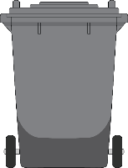
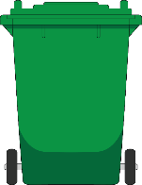


Ordinance 759
Irwindale Municipal Code single family homes
8.22.040
Organic Waste Collection Services
Three-Container “source separated” Collection Service
Organics prohibited from black container
All organic waste segregated for collection and recycling
Black
Container
Green
Container
Blue
Container
TRASH ONLY
Non-organic
Non-recyclable
ORGANICS ONLY
Food Waste
Yard Waste
Green Waste
Organic Matter
Food Soiled Paper
Pizza Boxes
RECYCLING ONLY
Bottles
Cans
Cardboard
Paper
Provide organics collection service to all RESIDENTS and businesses
Notes:
One element of this regulation is that jurisdictions are required to provide a mandatory organic waste curbside collection service to each of their residents and businesses.
Section 8.22.040 outlines the organic waste recycling program, which entails a three container source separated collection service. A black container for trash only; organics are prohibited. A green container for organics only, which consists of food, yard, and green waste, organic matter, food soiled paper, and pizza boxes. Blue container for recyclables such as bottles, cans, cardboard and paper. The regulations also require all residents and businesses to use an organic waste recycling service that meets the regulatory requirements.
Jurisdictions must have enforceable requirements on its haulers that collect organic waste in the jurisdiction, and for residential generators.
The single mixed waste container can no longer be used as single container mixed waste is now required to go to high diversion facilities that recover 75% of the organic content collected from the system, which very few to no facilities qualify for at this time including Athens Services.

Slide 8
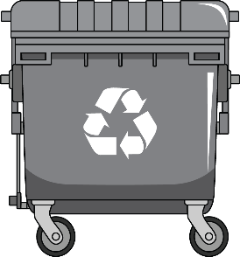
Ordinance 759
Irwindale Municipal Code businesses
8.22.050
Organic Waste Collection Services
Two-container Collection Service
All organic waste segregated for collection and recycling in a Green container; Organics prohibited from black container
One container for collection of mixed waste (trash & recyclables.
Black
Container
Green
Container
TRASH & RECYCLING ONLY
Non-organic
Non-recyclable
Bottles
Cans
Cardboard
Paper
ORGANICS ONLY
Food Waste
Yard Waste
Green Waste
Organic Matter
Food Soiled Paper
Pizza Boxes
Provide organics collection service to all residents and BUSINESSES.
Notes:
Section 8.22.050 establishes the mandatory organic waste curbside collection service for businesses.
Beginning January 1, 2020 through the city council approved 3rd Amendment with Athens Services and based on AB 1826, a mandatory organic waste curbside collection service for all businesses who generated 2 or more cubic yards of solid waste weekly was implemented. This section establishes this service, which includes a two container system of a Black Container with Trash & Recycling Only and a Green Container with Organics only. Businesses will continue to have an option to source separate their recyclable materials such as metals only, cardboard only, bottles/cans only, etc.

Slide 9

Ordinance 759
Irwindale Municipal Code waivers for generators
8.22.060
Waivers for Generators
De Minimis Waivers
Proof Business/Multi-family Generates less than:
  20 gallons or less of organic waste if solid waste collection is 2 cubic yards or more per week
  10 gallons or less of organic waste if solid waste collection is less than 2 cubic yards per week
Must Submit Written Verification Every 5 Years
Physical Space Waivers
Business or Multi-family lacks adequate space for collection containers
Must Submit an Exemption Form & Provide Evidence
Review & Approval
Waivers will be reviewed & approved by the Public Services Director or a designee of the Public Services Director.
Provide organics collection service to all residents and BUSINESSES.
Notes:
Section 8.22.060 establishes waivers for generators. The two separate waivers that business and multi-family generators includes De Minimis and Physical Space waivers. De Minimis Waivers include businesses or multi-family homes who generate 20 gallons or less of organic waste if solid waste collection is 2 cubic yards or more per week. OR generate 10 gallons or less of organic waste if solid waste collection is less than 2 cubic yards per week. The businesses or multi-family generator must submit to the City written verification every 5 years.
The second waiver available is the Physical Space Waiver that allows for business and multi-family generators who lack adequate space for their containers to submit an exemption form and provide evidence of such lack of space.
The Review & Approval of these waivers will be at the discretion of the Public Service Director or her designee.

Slide 10

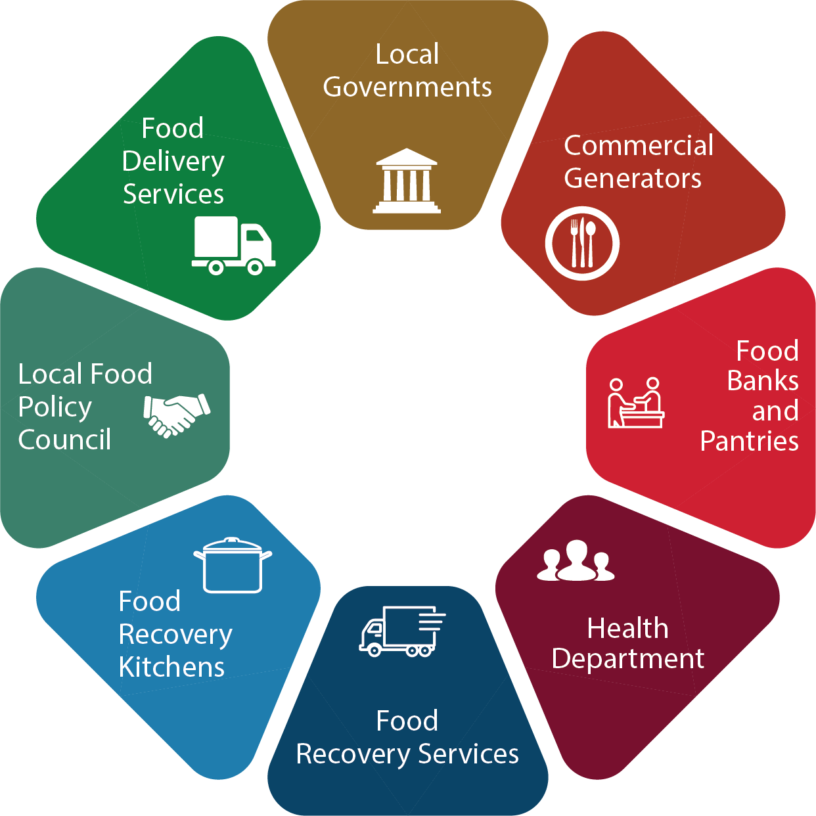

Ordinance 759
Irwindale Municipal Code
edible food generators
8.22.070
food recovery organizations/services
8.22.080
EDIBLE FOOD RECOVERY PROGRAM
Tier One Commercial Edible Food Generators
Tier Two Commercial Edible Food Generators
Large Venues/Large Event Centers
Identify Existing Food Recovery Capacity
Monitor Commercial Edible Food Generators for Compliance
Ensure Commercial Edible Food Generators Have Access to Food Recovery Services
Expand Existing Food Recovery Capacity (if needed)
Irwindale is Part of the SGVCOG Regional Edible Food Recovery Program
Establish Edible Food Recovery Program
Notes:
SB 1383 requires that jurisdictions strengthen its existing infrastructure for edible food recovery and distribution by implementing an Edible Food Recovery Program in their communities. This includes:
Assessing and Identifying Capacity of Existing Food Recovery
Establishing an Edible Food Recovery Program
Inspecting Commercial Generators for Compliance
Conducting Education and Outreach
Ensuring Commercial Edible Food Generators have access to Food Recovery Organizations and Services
Expand Existing Food Recovery Capacity if needed
There are new recordkeeping and inspection tasks that need to be implemented for communities where existing infrastructure already exist.
On September 22nd, the City Council approved the City’s participation in the San Gabriel Valley Council of Governments Regional Food Recovery Program to determine food recovery capacity for Tier 1 & 2 Edible Food Generators, compliance assessment, and public education and outreach. On November 10th, City Council amended the Memorandum of Agreement to add an inspection and enforcement program. Under this section of the ordinance, City Staff will still be responsible for sending the Notice of Violations to the entity not in compliance with SB 1383.

Slide 11
Ordinance 759
Irwindale Municipal Code
haulers & facility operators
8.22.090
self haulers
8.22.100
REQUIREMENTS for. . .
Haulers & Facility Operators
Meet Requirements for Organic Waste Collection Services for Residential, Businesses and Multi-family Generators:
  Reporting
  Transport
  Compliance
  Facility Operators - Capacity Planning
  Community Composting Operators – Estimate Organic Waste Capacity
Self Haulers
Shall Source Separate All Recyclables & Organic Waste
Shall Self-haul to a Facility that Recovers Such Material
Keep Record of Organic Waste
Requirements for Haulers Facility Operator & Self Haulers
Notes:
Under Section 8.22.090, Haulers are required to
Report Where Organic Waste is Transported
Ensure Organic Waste is transported to an Organic Waste Recovery Facility including City Approval to Transport to Community Composting Site or C&D facility
Comply with SB 1383 including education, equipment, signage, container labeling, container colors, contamination monitoring, and reporting.
Organic Recovery Operators must provide Information on Available, Potential New and Expanded Capacity
Community Composting Operators must provide an Estimate of Anticipated Organic Waste Capacity
Under Section 8.22.100, Self-haulers are required to
Source Separate All Recyclables & Organic Waste
Self-haul to a Facility that Recovers Recyclables & Organic Waste
Keep Record of Organic Waste transported through the delivery of receipts or weight tickets. The amount of materials in cubic yards or tons transported by the generator to each entity must be on the receipt or weight tickets.
Residential organic waste generators that self-haul organic waste are not required to record or report their information.

Slide 12
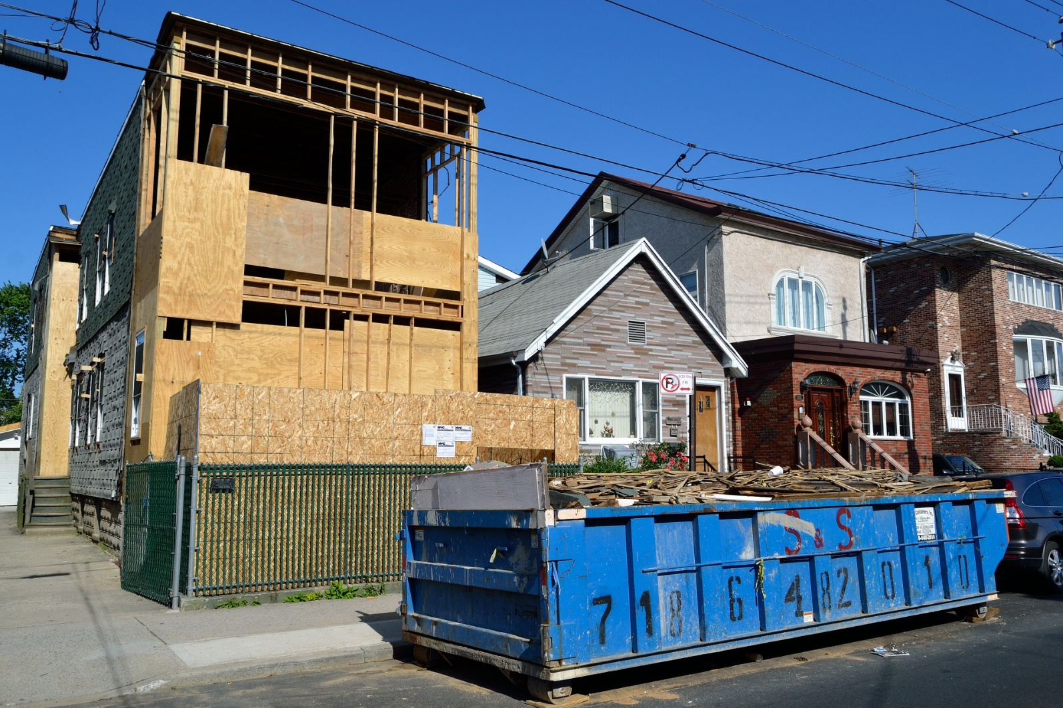
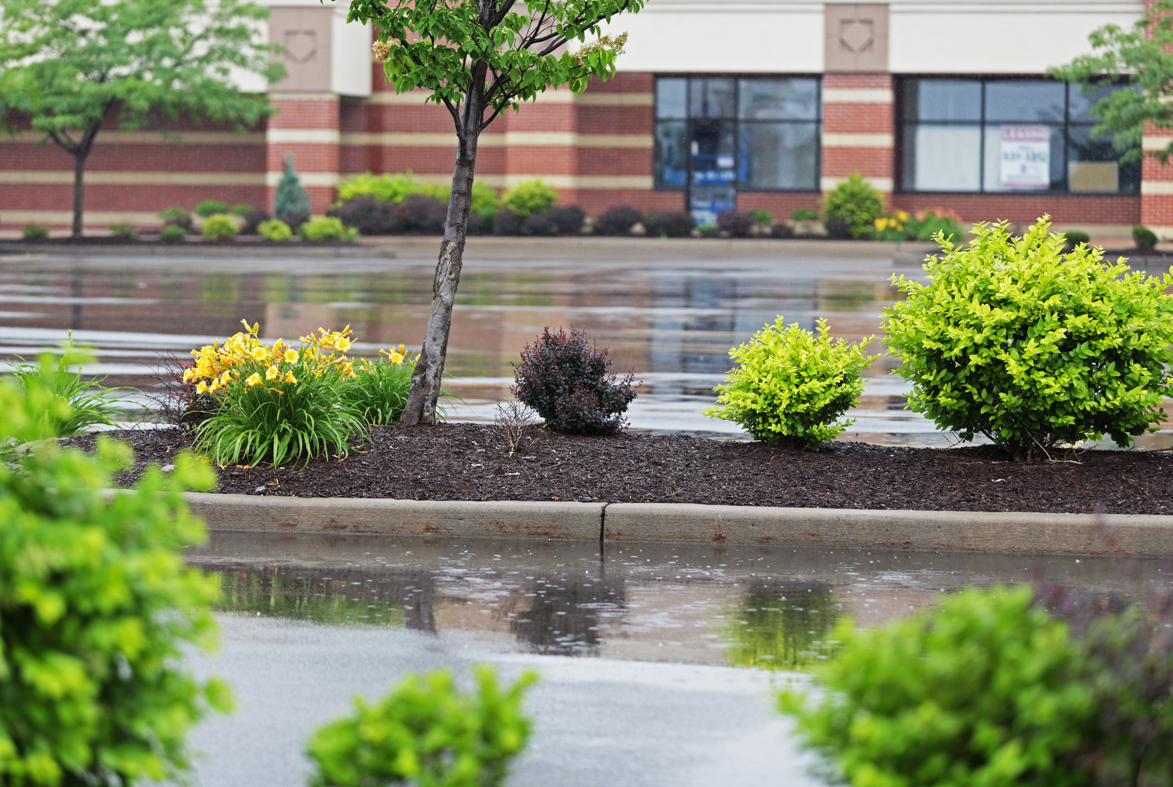
Construction & Landscaping Requirements
Ordinance 759
8.22.120
IMC 15.30
Model Water Efficient Landscape Ordinance (MWELO) requirements for compost and mulch application.
8.22.110
IMC 15.10, 8.20.301
Recycling organic waste commingled with C&D debris, to meet CalGreen 65% requirement for C&D recycling in both residential and non-residential projects
Notes:
The City of Irwindale has already adopted an ordinance in compliance with CalGreen and Model Water Efficient Landscape requirements. Irwindale Municipal Code Section 15.10 covers the adoption by reference of the California Green Building Standards Code with LA County amendments. Section 8.20.301 covers the City’s Construction and Debris Ordinance. Section 8.22.110 of Ordinance 759 references both IMC 15.10 and 8.20.301 requiring 65% recycling requirement for new residential or non-residential construction.
Any new landscaping projects that are more than 500 square feet must meet the Model Water Efficient Landscape Requirements for compost and mulch application as outlined in the IMC Section 15.30 and under Section 8.22.120 of Ordinance 759.

Slide 13




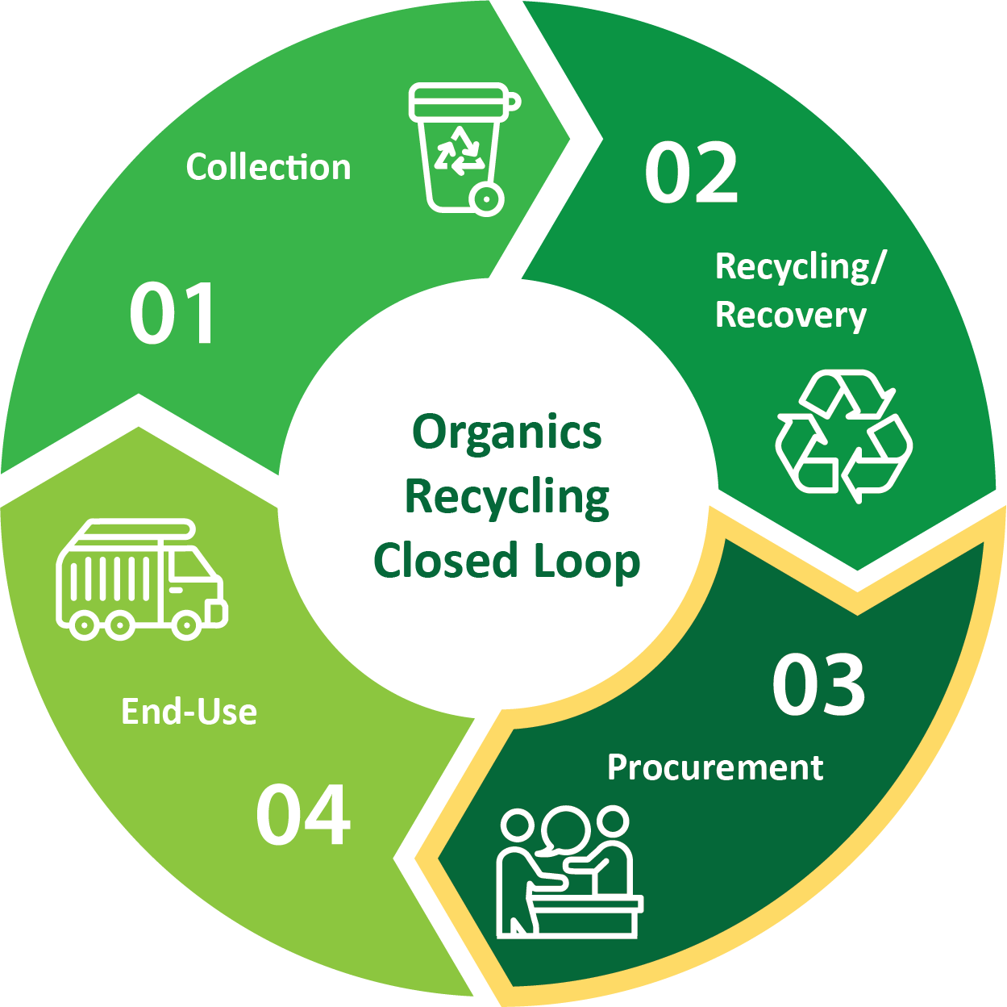






Ordinance 759
Irwindale Municipal Code
Procurement Requirements for City Departments, Direct service providers & Vendors
8.22.130
Recovered organic waste product procurement Requirements
COMPOST, MULCH, RENEWABLE NATURAL GAS & ELECTRICITY
Procurement Target
City Council
Board of
Supervisors
Public
Transportation
Fleets
City Manager
CAO
PAPER PROCUREMENT REQUIREMENTS
Recycled Content
Recyclability
Environmental Health
Finance
Legal
PROCUREMENT OPTIONS
Direct Procurement
Direct Service Provider
Public Parks
Purchasing
Public
Works
Procure Recycled and Recovered Organic Products
Notes:
Beginning January 1, 2022, each jurisdiction will have an annual procurement target, which establishes the minimum quantity of recovered organic waste products required to be purchased. This target is based on a jurisdiction’s population size. CalRecycle recently released each jurisdiction’s requirement with the City of Irwindale’s procurement amount at 115 tons.
On November 10, 2021, City Council adopted a citywide Recovered Organic Waste Product Procurement Policy that will assist City Staff in meeting targets through the purchase of compost, mulch, or renewable gas. Additionally, the City can meet their target through a direct service provider, such as Athens Services’ compost giveaway & use of renewable gas for their trucks, or Vendors that can provide SB 1383 Eligible mulch.
Separate from the procurement target, SB 1383 also requires that jurisdictions procure recycled-content paper, which includes printing/writing paper/paper products, when it is available at the same price or less than non-recycled material. There are recordkeeping requirements for both the procurement of recovered organic waste products and recycled-content paper. This law extends beyond public services or works staff. Each department will need to understand how SB 1383 impacts their work. Recordkeeping and reporting requirements extend to all of these departments, & jurisdiction leaders will play a vital role in ensuring compliance with SB 1383. Each department is required to purchase recycled-content paper. City Council is responsible for adopting policies & an SB 1383 ordinance; the City Attorney’s office is responsible for reviewing all legal documents pertaining to SB 1383; Public Services staff are involved with hauler agreements, waiver approval, outreach and education, recovered organic waste procurement targets. Public Works/Building & Safety is responsible for C&D requirements; Planning for Model Water Efficient Landscaping Requirements; and Finance for assisting Public Services with gathering all invoices pertaining to Recovered Organic Waste Procurement and Recycled-content paper purchases.

Slide 14


Ordinance 759 inspections & investigations
8.22.140 enforcement
8.22.150
INSPECTION & ENFORCEEMENT REQUIREMENTS
Compliance Monitoring & Education
2022-2024
Compliance Monitoring & Enforcement
2024
Ordinance
2022
Adopt an Ordinance
Including Inspections & Enforcement
Annual Compliance Reviews, Route Reviews, Inspections
Educate Violators
Annual Compliance Reviews
Route Reviews, Inspections,
Notice of Violations,
Penalties for Violators
Monitor Compliance and Conduct Enforcement
Notes:
By January 1, 2022, jurisdictions are required to have:
An enforcement mechanism or ordinance in place including inspections and enforcement.
Enforcement will not occur until 2024.
Between Jan 2022 and Dec 2023, jurisdictions are required to identify regulated entities in violation of SB 1383 and provide educational material.
The focus during the first 2 years is on educating generators, annual compliance reviews, route reviews, and inspections.
With the goal of ensuring every generator has an opportunity to comply before mandatory enforcement goes into effect in 2024.
After January 2024, jurisdictions must take progressive enforcement against organic waste generators that are not in compliance, which includes notifying the generator through a Notice of Violation within 60 days of determining a violation and providing time for the generator to comply before penalties are required to be issued by the City. Administrative citations (penalties) will be issued to a generator that does not meet the time limits outlined in the NOV.
Section 8.22.150, sets penalty amounts. 1st violation is $100 per violation; 2nd violation is $200 per violation; and 3rd or subsequent violation is $500 per violation.

Slide 15






SB 1383 in Action
Jurisdiction Requirements
Recordkeeping Requirements:
Organic Collection Services
Hauler Program
Contamination Minimization
Waivers
Education & Outreach
Maintain Records and Report to CalRecycle
Edible Food Recovery Program
Recycled Organic Waste Procurement
Recycled Paper Procurement
Commercial Edible Food Generators
Jurisdiction Inspection & Enforcement
Notes:
Each jurisdiction including the City of Irwindale is required to maintain all information in an Implementation Record. This graphic is a snapshot of items to be kept in the Implementation Record.
Each section requires a minimum level of recordkeeping such as “ordinances, contracts, and franchise agreements”.
CalRecycle will review the implementation record as part of a compliance evaluation of the City of Irwindale’s program.
The Implementation Record needs to be stored in one central location
It can be kept as a physical or electronic record
It needs to be accessible to CalRecycle staff within ten business days
It needs to be retained for five years

Slide 16

State Enforcement
CalRecycle Oversight (Begins in 2022)
Oversee and Monitor for Compliance
Jurisdictions
State Agencies and Facilities
Local Education Agencies
Review Reports, Records and Authorize Waivers
Annual Reports
Implementation Record
Low Population Waivers
Rural Area Waivers
Emergency Circumstances Notifications
If Violations
Issue Notices of Violation
Approve Corrective Action Plan
Allows up to 24 months to address barriers outside of a jurisdiction’s control
May be subject to penalties
Notes:
CalRecycle will be overseeing and monitoring Jurisdictions, including the City of Irwindale for compliance under SB 1383 and to ensure we have implemented our programs including an approved Ordinance, adopted Procurement Policy, an Edible Food Recovery Program, Education and Outreach campaigns, Hauler Contract Amendments including Mandatory Organics Recycling Services for Residential and Businesses.
SB 1383 is a Statewide target and not a jurisdiction organic waste diversion target.
Under the SB 1383 regulations, if CalRecycle determines a jurisdiction is violating one or more of the requirements,
A jurisdiction will be issued a Notice of Violation and provided up to 90 days to correct the violation(s). If a jurisdiction needs additional time, CalRecyle may provide an extension for up to 90 days.
For violations that are due to barriers outside the jurisdiction‘s control and may take more time to correct, the regulations allow for the jurisdiction to be placed on a Corrective Action Plan (CAP). This plan can allow up to 24 months to comply. In these cases, the jurisdiction needs to show it has taken substantial effort to comply but cannot do so due to extenuating circumstances.
A Corrective Action Plan issued due to inadequate organic waste recovery capacity may be extended for a period of up to 12 months if the jurisdiction meets the requirements and has demonstrated substantial effort to CalRecycle.
Failure to effectively implement SB 1383 could result in penalties of up to $10,000 per day.

Slide 17





Stay
Engaged
https://www2.calrecycle.ca.gov/Listservs/
Subscribe/152
https://www.calrecycle.ca.gov/organics/slcp
Elizabeth Rodriguez, Public Services Director
(626) 430-2211
erodriguez@irwindaleca.gov
Notes:
This concludes my presentation and I am available for any questions.

