Slide 1

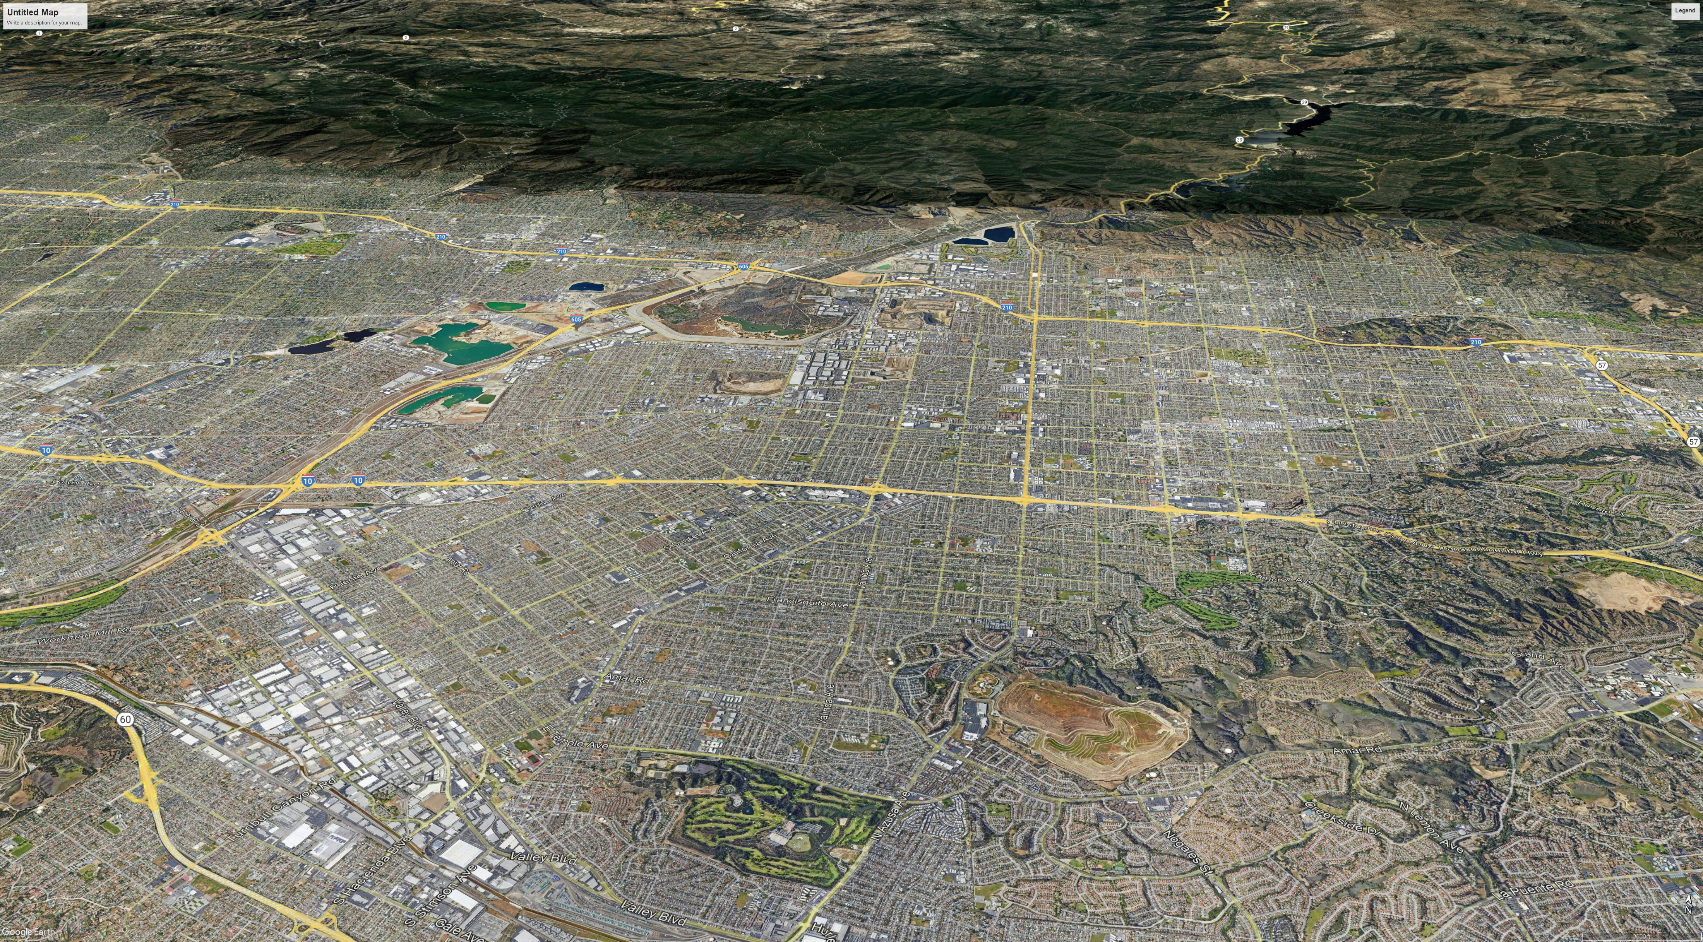
CITY OF IRWINDALE
General Plan Housing Element
COMMUNITY WORKSHOP
May 25th 2022

Slide 2
Meeting Purpose
Explore sites to accommodate Irwindale’s 2021 to 2029 Regional Housing Need Allocation (RHNA)
This meeting is not about any City sponsored residential development, including the housing lottery or being placed on an interest list.

Slide 3
Agenda
Introductions (5 min.)
What is a Housing Element (5 min.)?
Irwindale’s 2021 to 2029 RHNA and Household Income Levels (10 min.)
What does density look like? (5 min.)
Criteria for housing sites (5 min.)
Review possible housing sites (10 min.)
Focus on Allen Street site and discuss options (45 min.)
Next Steps (5 min.)

Slide 4
Meeting Guidelines
Please mute yourself when you’re not speaking.
Please share video so we can stay visually connected.
In addition to collecting surveys, public comments and participation are welcomed tonight through in-person comments and for our Zoom participants, by typing questions and comments into the chat. Comments will be received first from our in person attendees, followed by virtual comments and questions to be announced by staff.
In the interest of time, questions and comments that are similar or repetitive in nature will be consolidated.
Please use raise hand function or chatbox to ask questions or provide a comment.
Respect each others’ opinions.
Please be flexible and patient (technology issues happen).
Remember: This is just one meeting in a longer process and we will have other community workshop events and public meetings to discuss the Housing Element Update.

Slide 5
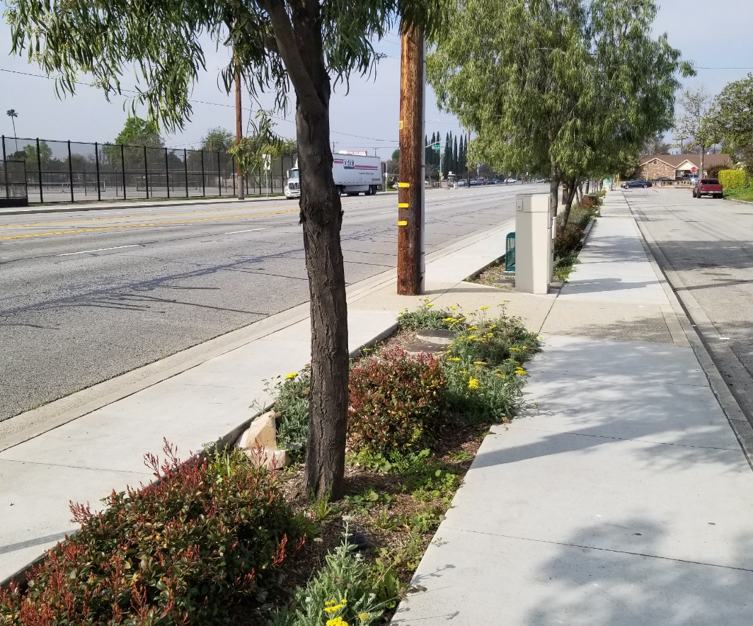
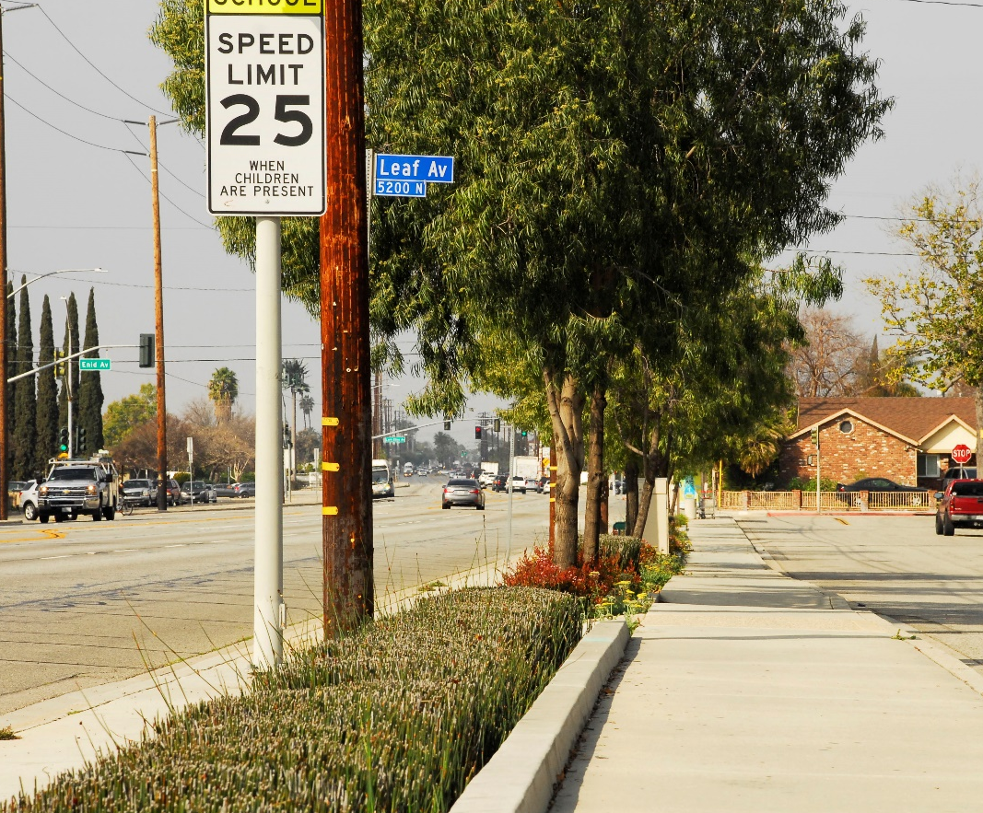
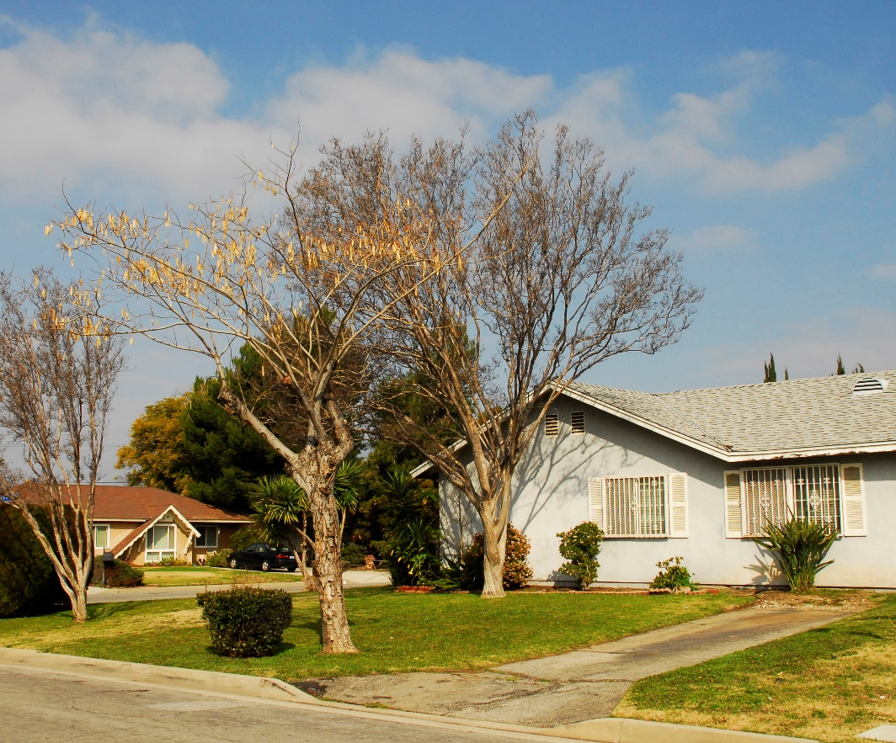
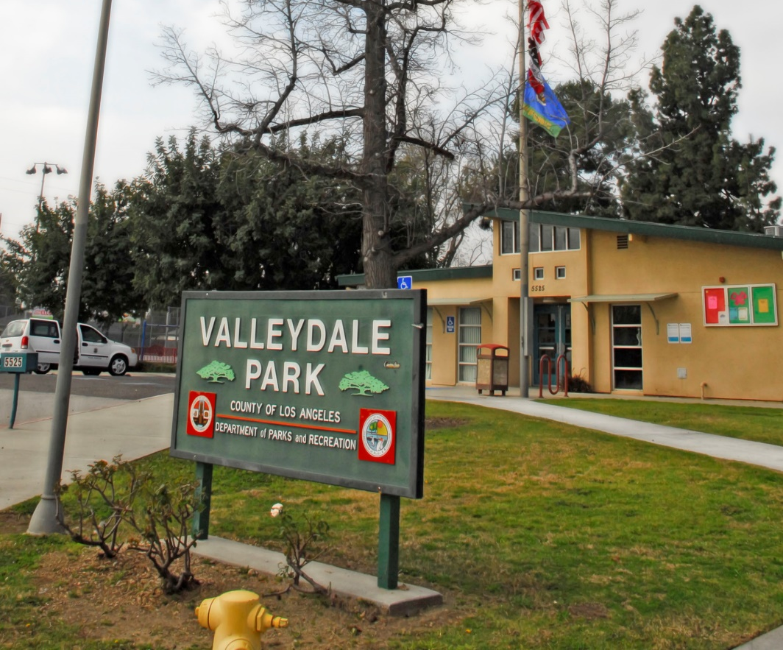
Introductions

Slide 6

What is a Housing Element?

Slide 7
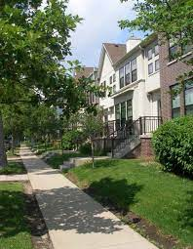
What is the Housing Element?
City plan to meet housing needs
To meet community needs
To provide access to opportunity
One Element of the General Plan
Required for every City and County in California
Updated every 8 years
Approved by CA Department of Housing & Community Development
Housing Elements for cities in Los Angeles County cover 2021-2029
Housing Element Law is contained in CA Govt. Code, Section 65580 et. seq.
Notes:
– MATT–

Slide 8
Key Housing Element Objectives
Housing Production: Accommodate projected (RHNA-allocated) housing units, particularly affordable housing
Housing Preservation: Protect & rehabilitate affordable housing
Affirmatively Further Fair Housing: Foster an inclusive community that provides equal access to opportunity
Housing for All: Promote housing for all income levels and special-needs populations

Slide 9
2021-2029 RHNA and Income Levels

Slide 10
What is the Regional Housing Needs Allocation (RHNA)?
Number of housing units that Irwindale must plan for over the next 8 years
Projected Statewide need allocated to each region, then to each city and county
RHNA includes units to meet housing needs at all income levels
Irwindale’s 2021-2029 RHNA: 119 Units
Housing Element must show the City’s ability to meet the RHNA
By identifying sites for development, removing barriers, facilitating development
City is not required to build the units
Sites must meet criteria defined by the State
Zoned for residential use, access to utilities, able to be developed in planning period
Sites for lower-income units must typically allow 20+ dwelling units per acre

Slide 11
Irwindale RHNA
INCOME LEVEL | 2013-2021 Allocation | 2021-2029 Allocation | Percent of 2023-2031 Total
VERY LOW INCOME (<50% Area Median Income) | 4 | 36 | 30%
LOW INCOME (50-80% Area Median Income) | 2 | 11 | 9%
MODERATE INCOME (80-120% Area Median Income) | 2 | 17 | 14%
ABOVE MODERATE INCOME (>120% Area Median Income) | 7 | 55 | 46%
TOTAL | 15 | 119 | 100%
Notes:
– MATT–

Slide 12
2022 Household Income Levels
Income Category/ Household Size | 1 Person | 2 Person | 3 Person | 4 Person | 5 Person | 6 Person
Very Low-Income | $41,700 or less | $47,650 or less | $53,600 or less | $59,550 or less | $64,350 or less | $69,100 or less
Low-Income | $47,101 to $66,750 | $47,651 to $76,250 | $53,601to $85,800 | $59,551 to $95,300 | $64,351 to $102,950 | $69,101 to $110,550
Moderate-Income | $66,751 to 76,500 | $76,251 to $87,450 | $85,801 to $98,350 | $95,301 to $109,300 | $102,951 to $118,300 | $110,551 to $126,800
Above Moderate-Income | $76,501 and above | $87,451 and above | $98,351 and above | $109,301 and above | $118,301 and above | $126,801 and above

Slide 13
How much land do we need to identify for RHNA?
Need sufficient land to accommodate the RHNA
Very low- and Low-Income (Lower-Income) ~ 2-3 acres or more for multifamily development
Moderate-Income ~ 1-2 acres or more for multifamily development
Above Moderate-Income ~ 12-14 acres or more for single-family development (or fewer acres at higher density)
Should also include a “buffer” of 20 to 30% for each income category

Slide 14
What does density look like?

Slide 15
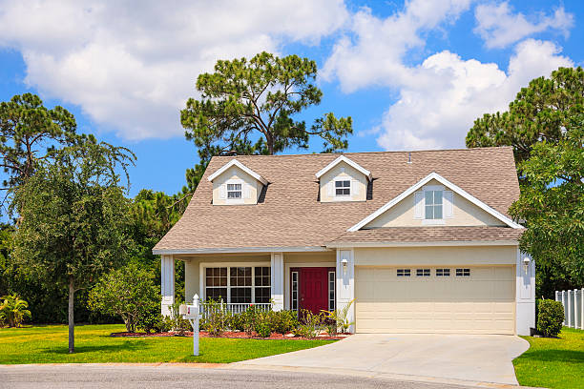
Single-family detached housing
up to 9 dwelling units per acre
1 to 2 stories
Attached garages

Slide 16
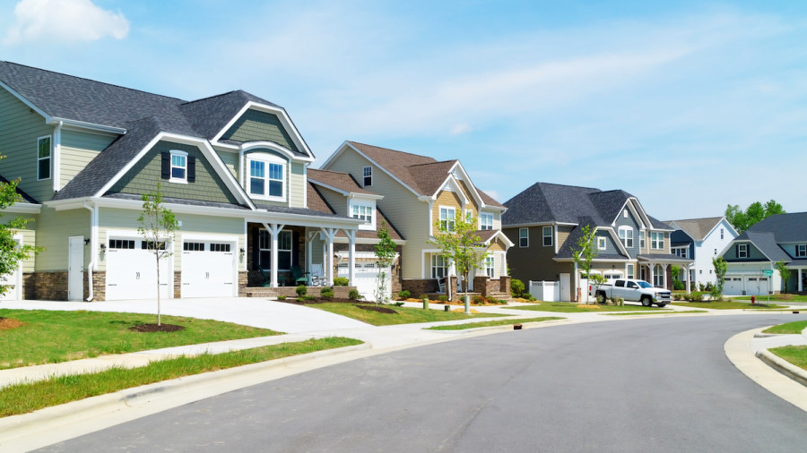
Small Lot/Zero Lot Line Single-Family Detached
10 to 12 dwelling units per acre
1 to 2 stories
Attached garages

Slide 17
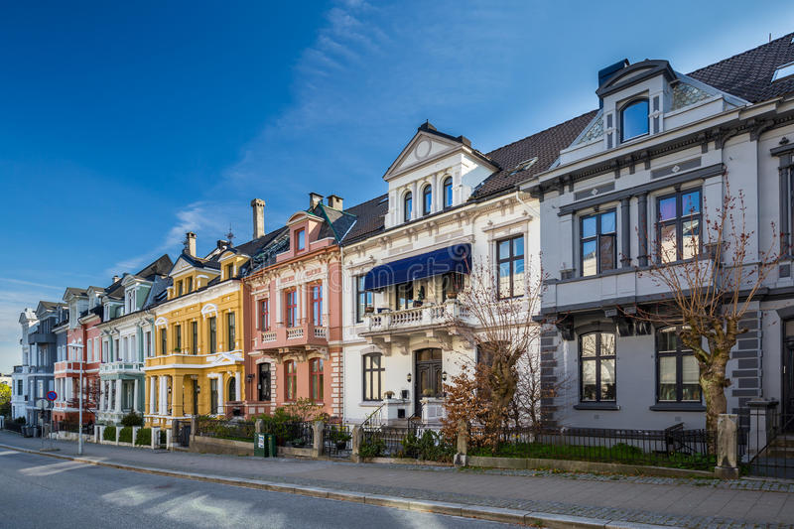
Townhouse/Rowhouse
12 to 18 dwelling units per acre
2 to 3 stories
Tuck-under parking

Slide 18
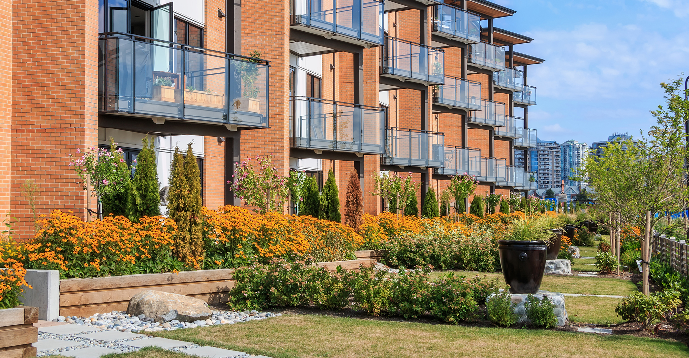
Garden Style Apartments
20 to 30 dwelling units per acre
2 to 3 stories
Surface parking

Slide 19
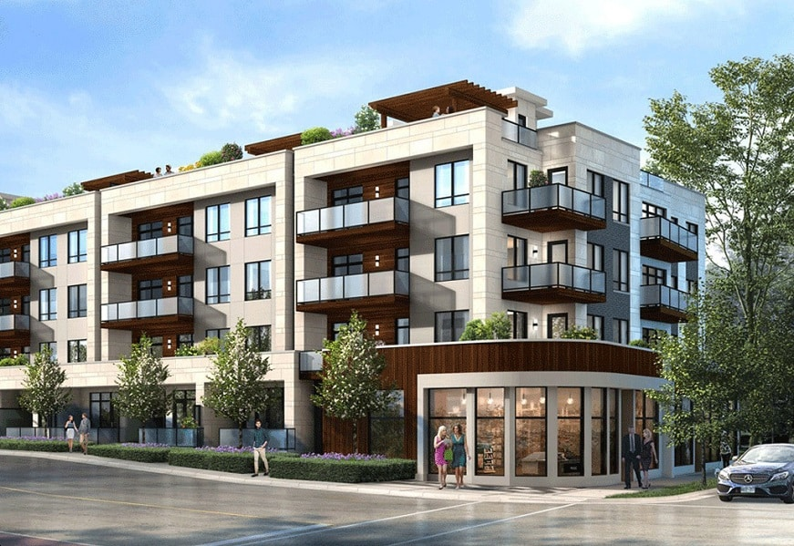
Podium Apartments/Condos
50 to 120+ dwelling units per acre
3 to 6 stories
1 to 2 levels parking podium with 2 to 5 stories of residential above

Slide 20
Criteria for Housing Sites

Slide 21
General Criteria
Between 0.5 and 10 acres in size
Infrastructure available to serve the site
Does not have environmental constraints
Surrounding land uses are compatible
Vacant, or likely to be redeveloped in the 2021 to 2029 timeframe

Slide 22
Additional Criteria for Very Low- and Low-Income Sites
Typically, must allow multifamily development of 20 dwelling units per acre or more
Should not over-concentrate lower-income housing in one part of the community
Lower-income housing should provide access to schools, jobs, shopping, and services

Slide 23
Review Potential Housing Sites

Slide 24
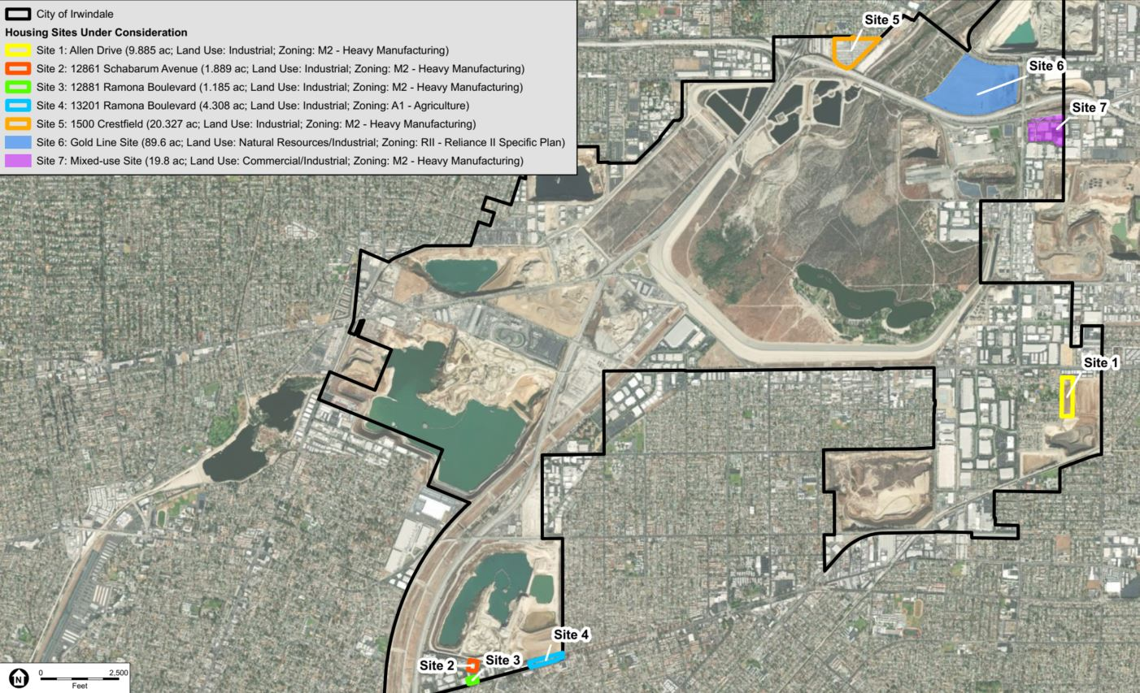

Slide 25
Summary Characteristics of Housing Sites
Site | Size (Acres) | Address/Cross Streets | Land Use | Zoning Code
1 | 10 | Allen Drive | Industrial | M2
2 | 2 | 12861 Schabarum Avenue | Industrial | M2
3 | 1 | 12881 Ramona Boulevard | Industrial | M2
4 | 4 | 13201 Ramona Boulevard | Industrial | A1
5 | 20 | 2500 E Central Avenue | Industrial | M2
6 | 90 | E Foothill Boulevard and N Irwindale Avenue | Natural Resources/Industrial | RII - Reliance II Specific Plan
7 | 20 | Irwindale Avenue and Avenida Padilla | Commercial/Industrial | M2

Slide 26
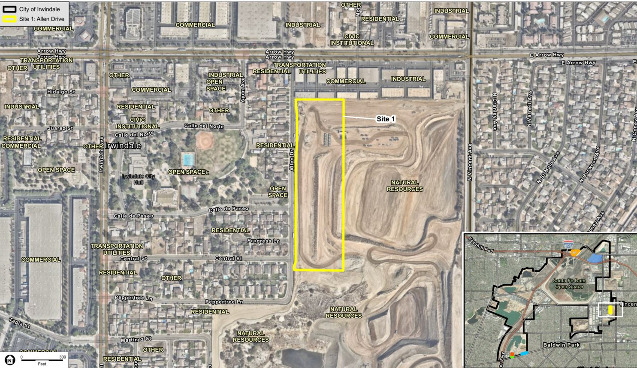

Slide 27
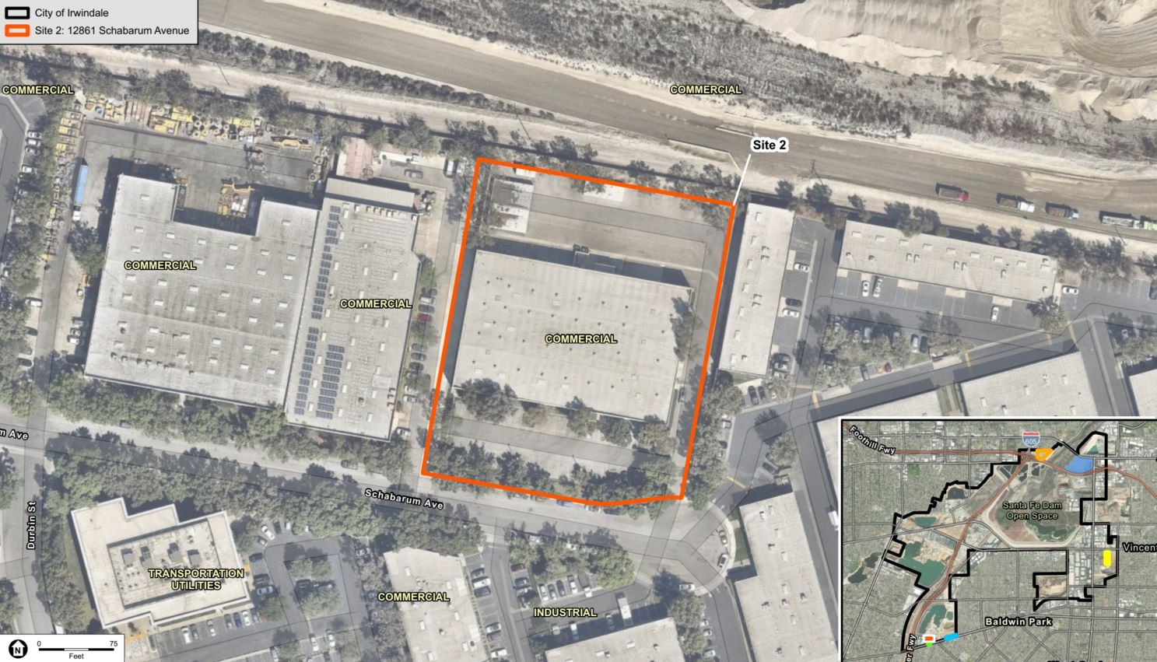

Slide 28
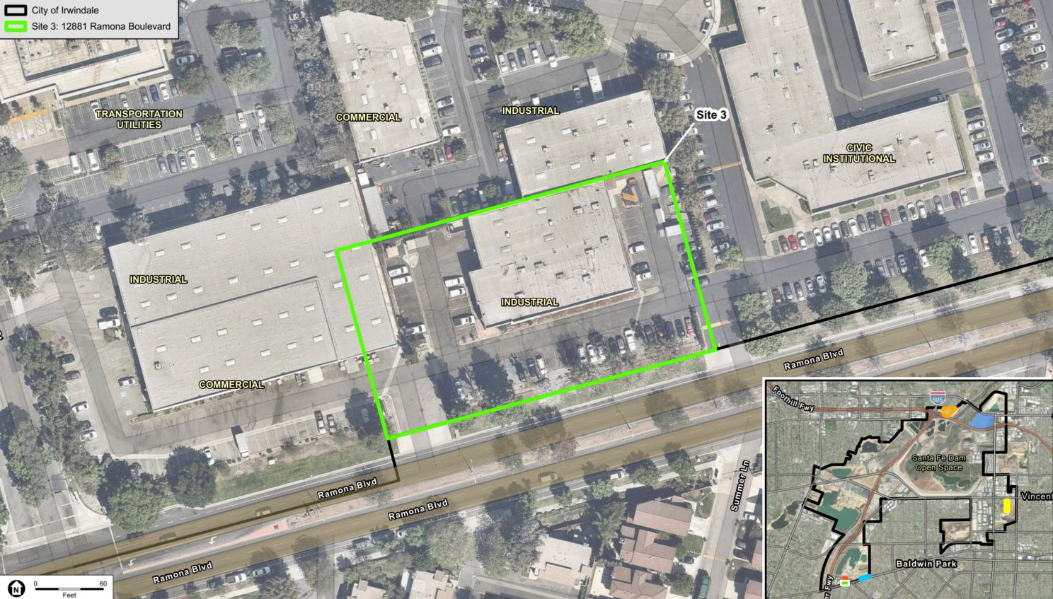

Slide 29
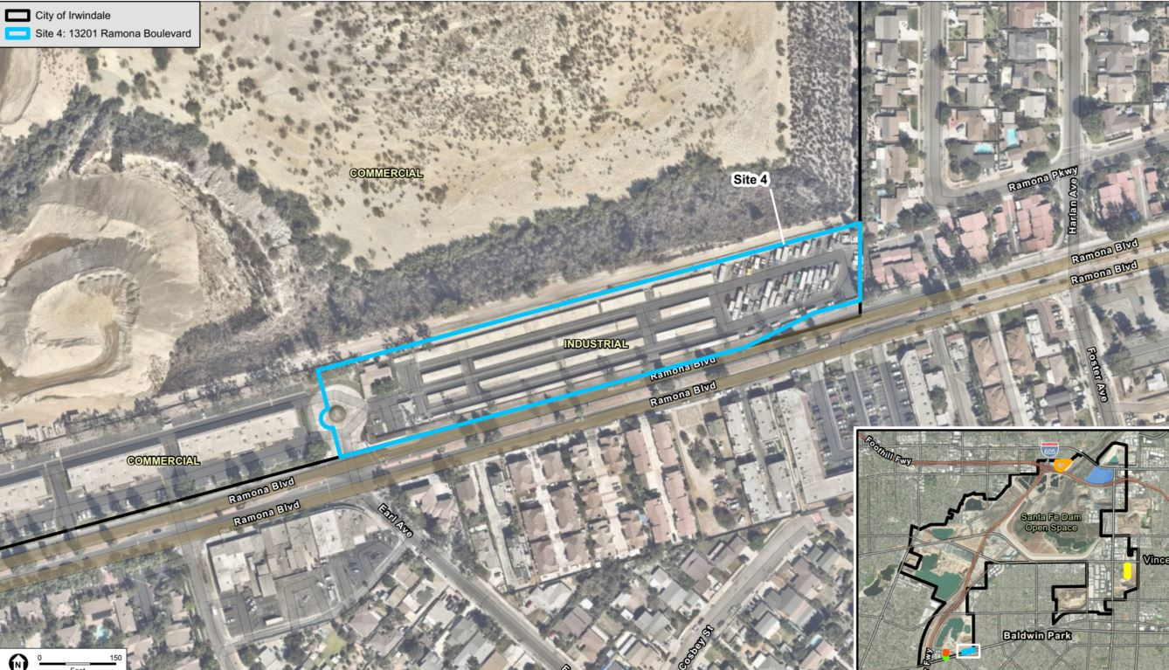

Slide 30
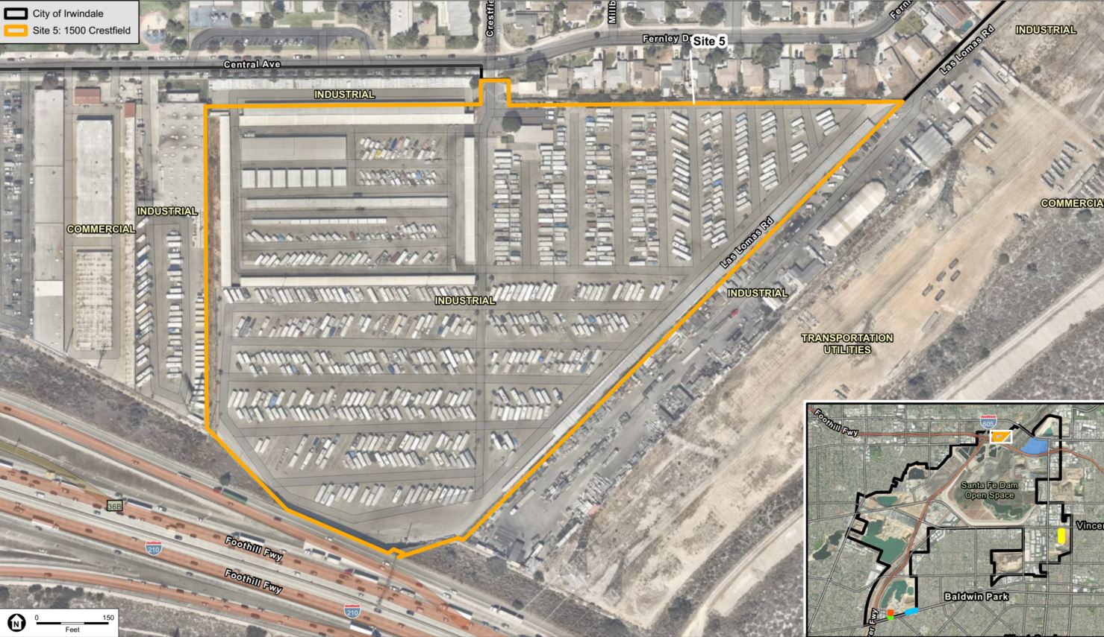

Slide 31
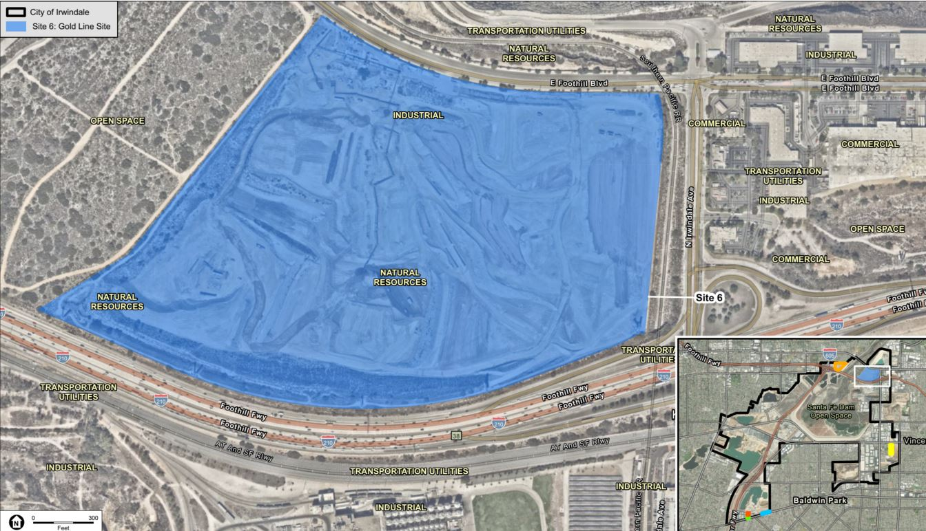

Slide 32
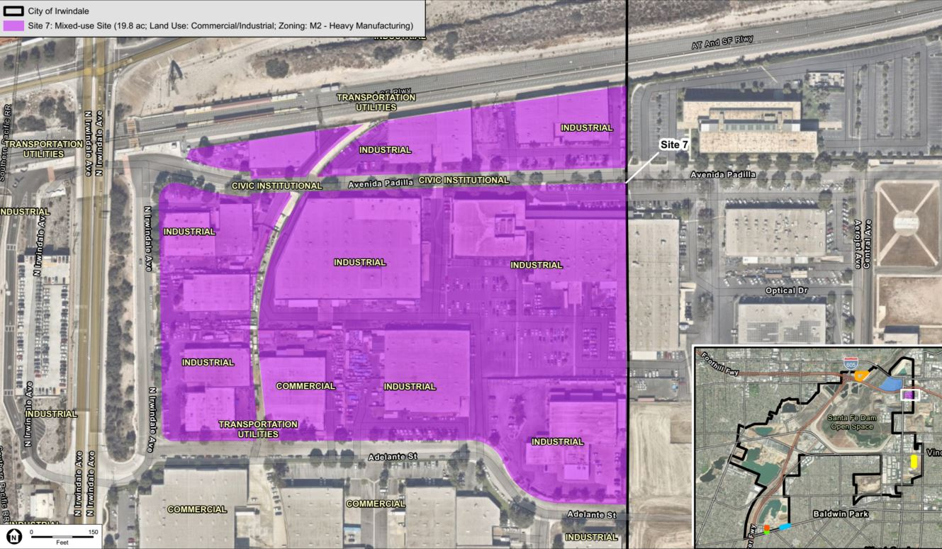

Slide 33
Initial reactions to preliminary sites list
Which sites do you think are good for housing?
Can you identify any problems with using any of the sites for housing?
Did we miss any sites that should be considered for housing development?

Slide 34
Allen Drive Site

Slide 36
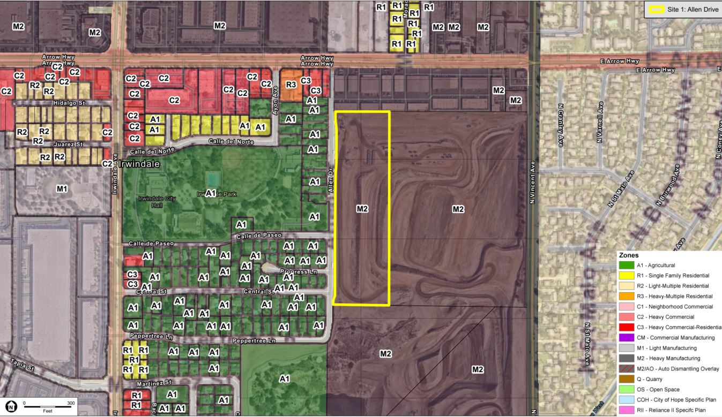

Slide 37
History of Allen Drive Site
Originally part of the 35-acre Manning Pit site.
Mining began in the 1930s and was completed in the 1970s.
Late 1980s – City acquired the site from Los Angeles County.
May 2010 to April 2019 – Remediation and fill complete.
Site was split into two parcels (10 acres and 25 acres).
2015 – 25-acre parcel sold for future private development.
Remaining 10-acre parcel owned by the City.
May 2021 – 10-acre site transferred to Irwindale Housing Authority.

Slide 38
Group Discussion of Potential Uses of Allen Drive Site
What kind of housing development would you like to see on this site?
In addition to housing, are there other uses that you would like to see on this site?
Where on this site would you place housing and other uses?

Slide 39
Next Steps for Housing Element
Obtain direction from City Council on housing sites (May 26th)
Prepare Public Review Draft Housing Element
Prepare Revised Draft Housing Element for CA HCD review
Revise Draft Housing Element in Response to HCD comments
Adopt Final Housing Element
Submit adopted Housing Element to HCD for review
Housing Element certification
Public Input

