Slide 1

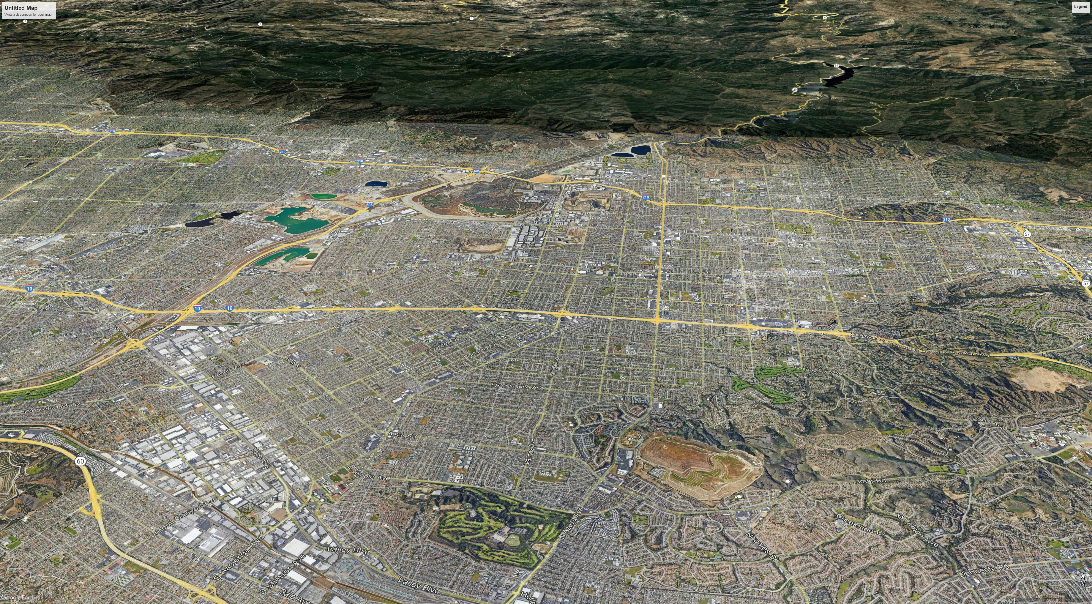
CITY OF IRWINDALE
General Plan Housing Element
COMMUNITY WORKSHOP
November 10, 2022

Slide 2

Welcome Bienvenidos
If you would need Spanish translation / Si necesitaría traducción al español
1. Click the Chat button at the bottom of your Zoom window and type “Spanish Translation” Haga clic en el botón Chat en la parte inferior de la ventana de Zoom y escribe
“traduccion en español”
2. Click the Interpretation button and select Spanish / Haga clic en el botón Interpretación y seleccione “Spanish” (Español)
Notes:
– MARIYLN (English) SYLVIA (Spanish) –

Slide 3

How to Use Zoom Video Conferencing
Mute/Unmute & Start/Stop Video
Chat: select the chat button to type in questions or comments
Reactions: show a nonverbal expression with an emoji or raise your hand to show you have a question/comment
Notes:
Steven

Slide 4
Meeting Guidelines
Please mute yourself when you’re not speaking.
Please share video so we can stay visually connected.
Public comments and participation are welcomed tonight through in-person comments and for our Zoom participants, by typing questions and comments into the chat. Comments will be received first from our in-person attendees, followed by virtual comments and questions to be announced by staff.
In the interest of time, questions and comments that are similar or repetitive in nature will be consolidated.
Please use raise hand function or chatbox to ask questions or provide a comment.
Respect each others’ opinions.
Please be flexible and patient (technology issues happen).
Remember: This is just one meeting in a longer process and we will have other public meetings to discuss the Housing Element Update.

Slide 5
Meeting Purpose
Present Public Review Draft of 2021-2029 Housing Element Update
Invite community feedback on the Draft
This meeting is not about any City sponsored residential development, including a housing lottery.
Public Review Draft Housing Element Update is available on City of Irwindale Housing Element & General Plan Update web page:
https://www.irwindaleca.gov/570/Housing-Element-General-Plan-Update

Slide 6
Agenda
Background on Housing Element Update (15 min.)
Review Housing Sites Inventory (10 min.)
Review Updated Housing Program List (15 min.)
Community Feedback (45 min.)
Next Steps (5 min.)

Slide 7
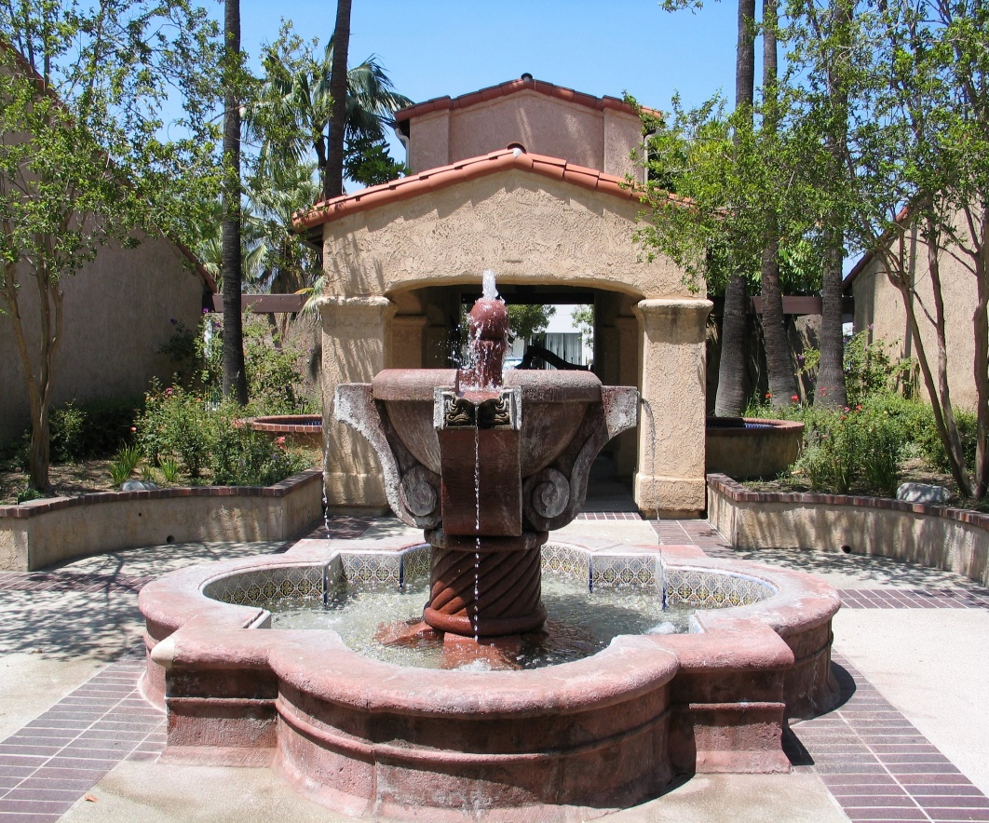
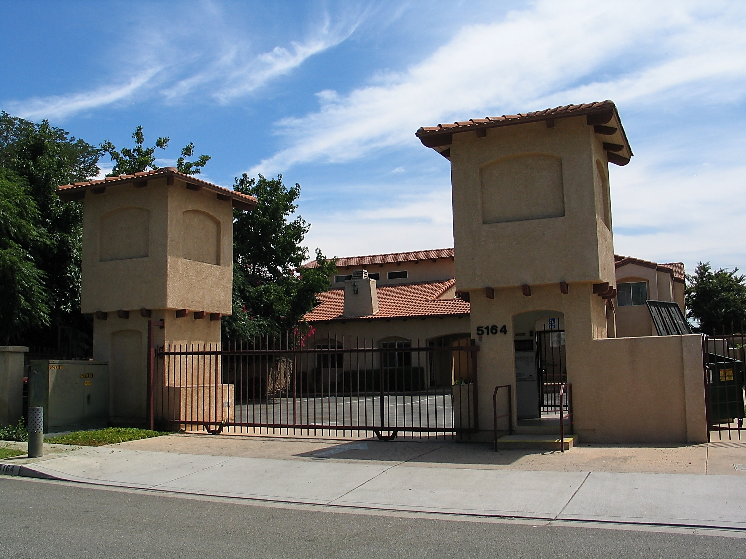
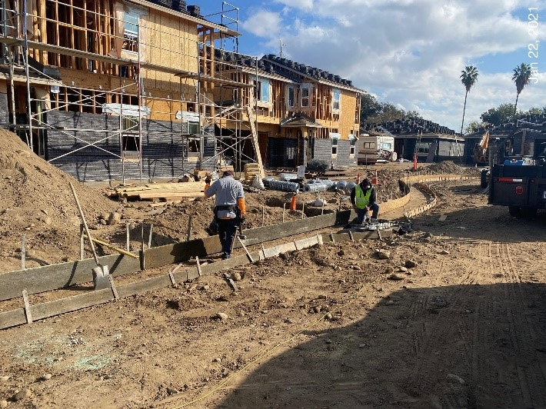
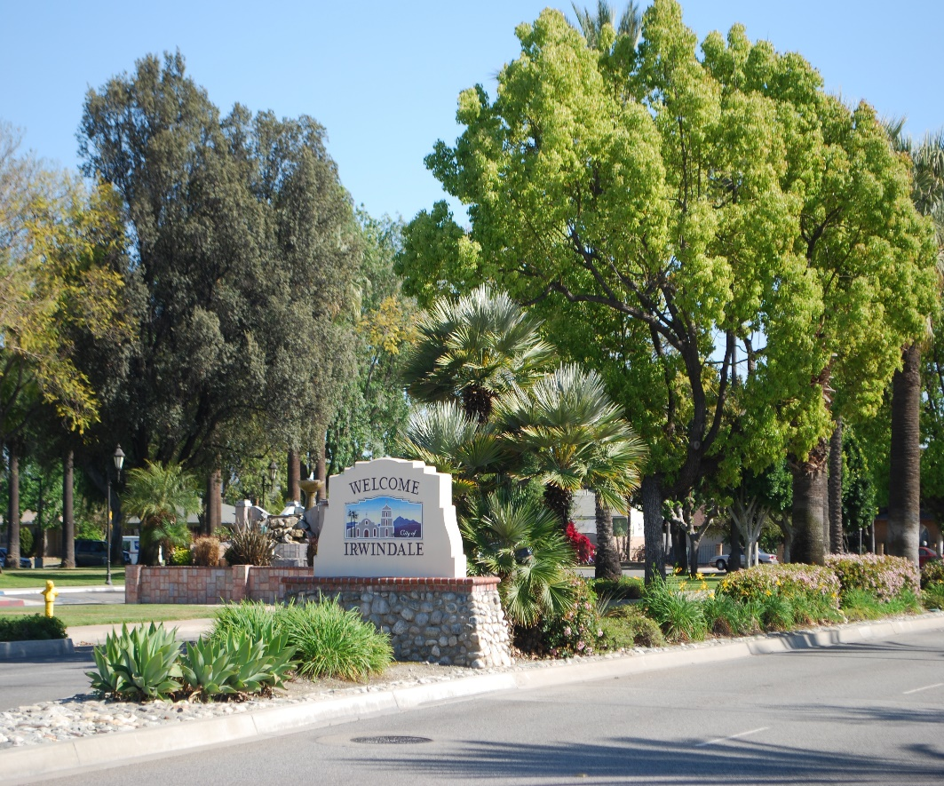
Introductions

Slide 8
What is a Housing Element?

Slide 9
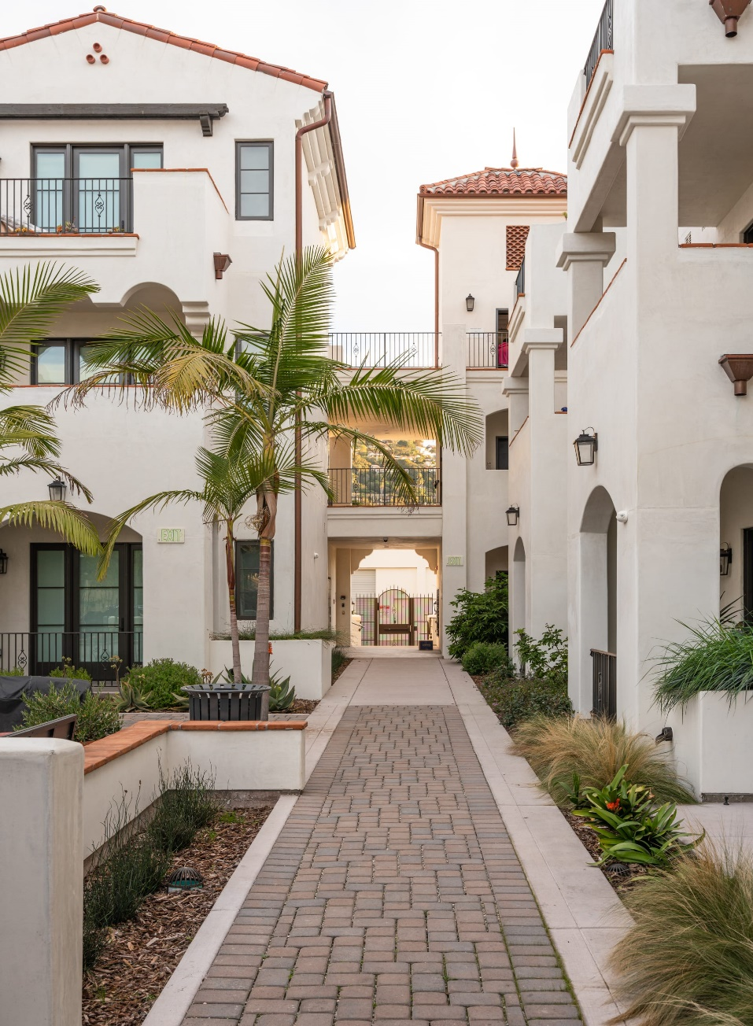
What is the Housing Element?
City plan to meet housing needs
To meet community needs
To provide access to opportunity
One Element of the General Plan
Required for every City and County in California
Updated every 8 years
Approved by CA Department of Housing & Community Development
Housing Elements for cities in Los Angeles County cover 2021-2029
Housing Element Law is contained in CA Govt. Code, Section 65580 et. seq.
Notes:
– MATT–

Slide 10
Key Housing Element Objectives
Housing Production: Accommodate projected (RHNA-allocated) housing units, particularly affordable housing
Housing Preservation: Protect & rehabilitate affordable housing
Affirmatively Further Fair Housing: Foster an inclusive community that provides equal access to opportunity
Housing for All: Promote housing for all income levels and special-needs populations

Slide 11
2021-2029 RHNA and Income Levels

Slide 12
What is the Regional Housing Needs Allocation (RHNA)?
Number of housing units that Irwindale must plan for over the next 8 years
Projected Statewide need allocated to each region, then to each city and county
RHNA includes units to meet housing needs at all income levels
Irwindale’s 2021-2029 RHNA: 119 Units
Housing Element must show the City’s ability to meet the RHNA
By identifying sites for development, removing barriers, facilitating development
City is not required to build the units
Sites must meet criteria defined by the State
Zoned for residential use, access to utilities, able to be developed in planning period
Sites for lower-income units must typically allow 20+ dwelling units per acre

Slide 13
Irwindale RHNA
INCOME LEVEL | 2013-2021 Allocation | 2021-2029 Allocation | Percent of 2023-2031 Total
VERY LOW INCOME (<50% Area Median Income) | 4 | 36 | 30%
LOW INCOME (50-80% Area Median Income) | 2 | 11 | 9%
MODERATE INCOME (80-120% Area Median Income) | 2 | 17 | 14%
ABOVE MODERATE INCOME (>120% Area Median Income) | 7 | 55 | 46%
TOTAL | 15 | 119 | 100%
Notes:
– MATT–

Slide 14
2022 Household Income Levels
Income Category/ Household Size | 1 Person | 2 Person | 3 Person | 4 Person | 5 Person | 6 Person
Very Low-Income | $41,700 or less | $47,650 or less | $53,600 or less | $59,550 or less | $64,350 or less | $69,100 or less
Low-Income | $47,101 to $66,750 | $47,651 to $76,250 | $53,601to $85,800 | $59,551 to $95,300 | $64,351 to $102,950 | $69,101 to $110,550
Moderate-Income | $66,751 to 76,500 | $76,251 to $87,450 | $85,801 to $98,350 | $95,301 to $109,300 | $102,951 to $118,300 | $110,551 to $126,800
Above Moderate-Income | $76,501 and above | $87,451 and above | $98,351 and above | $109,301 and above | $118,301 and above | $126,801 and above

Slide 15
What Does Density Look Like?

Slide 16
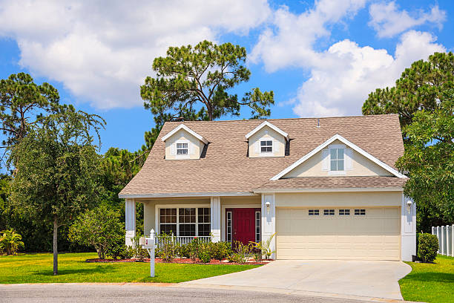
Single-Family Detached Housing
up to 9 dwelling units per acre
1 to 2 stories
Attached garages

Slide 17
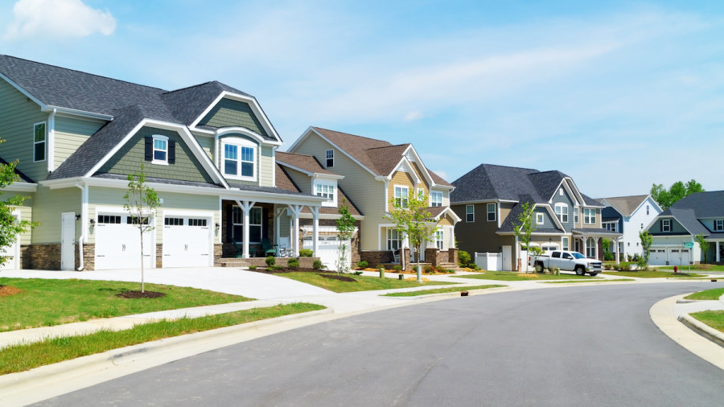
Small Lot/Zero Lot Line Single-Family Detached
10 to 12 dwelling units per acre
1 to 2 stories
Attached garages

Slide 18
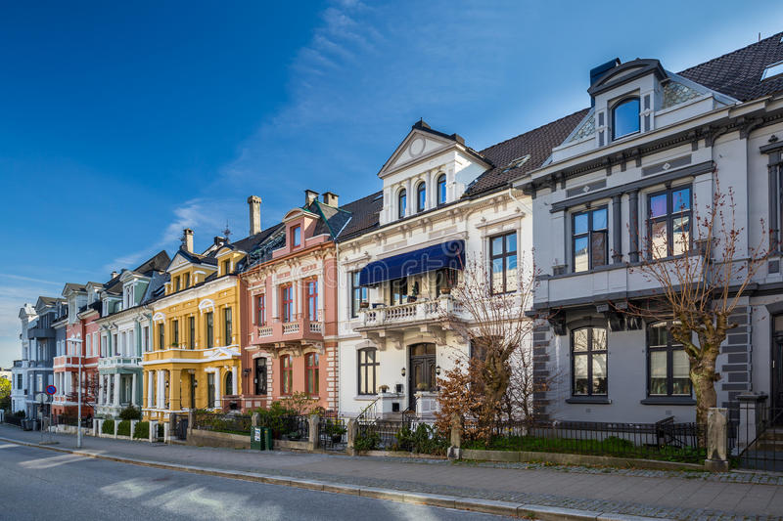
Townhouse/Rowhouse
12 to 18 dwelling units per acre
2 to 3 stories
Tuck-under parking

Slide 19
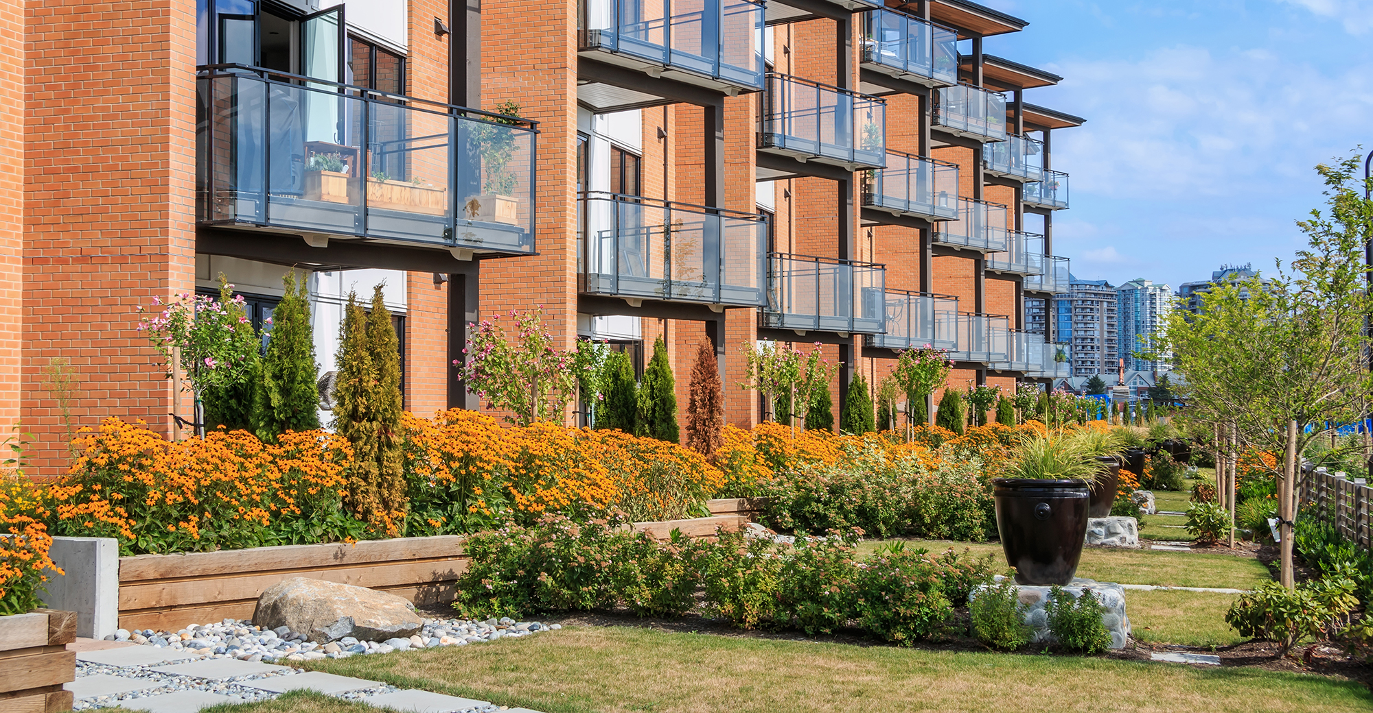
Garden Style Apartments
20 to 30 dwelling units per acre
2 to 3 stories
Surface parking

Slide 20
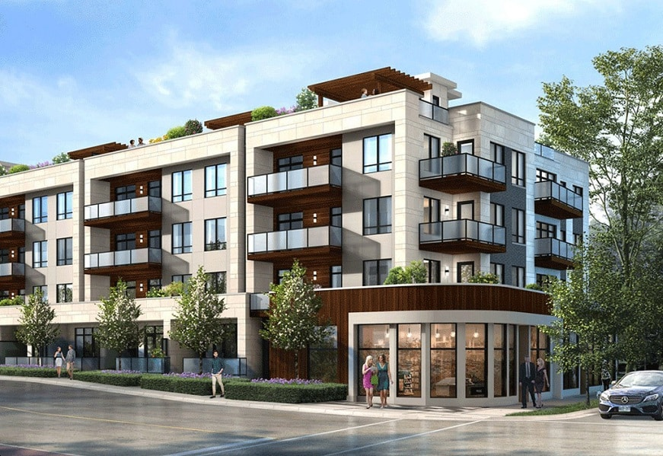
Podium Apartments/Condos
50 to 120+ dwelling units per acre
3 to 6 stories
1 to 2 levels parking podium with 2 to 5 stories of residential above

Slide 21
Criteria for Housing Sites

Slide 22
General Criteria
Between 0.5 and 10 acres in size
Infrastructure available to serve the site
Does not have environmental constraints
Surrounding land uses are compatible
Vacant, or likely to be redeveloped in the 2021 to 2029 timeframe

Slide 23
Additional Criteria for Very Low- and Low-Income Sites
Typically, must allow multifamily development of 20 dwelling units per acre or more
Should not over-concentrate lower-income housing in one part of the community
Lower-income housing should provide access to schools, jobs, shopping, and services

Slide 24
Proposed Housing Sites

Slide 25
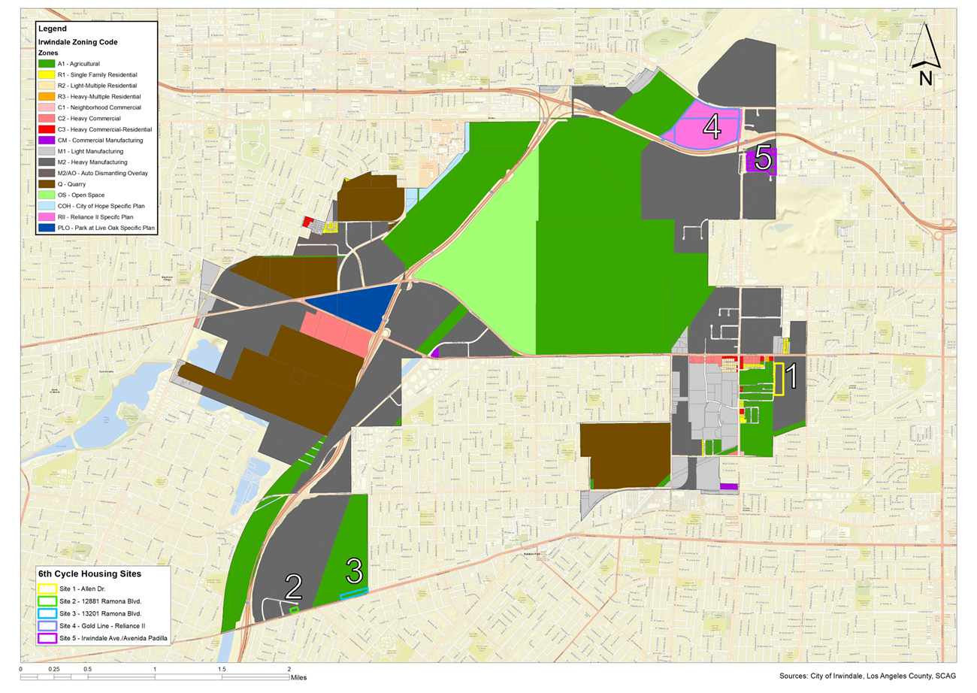
Housing Sites Overview

Slide 26
Summary Characteristics of Housing Sites

Slide 27
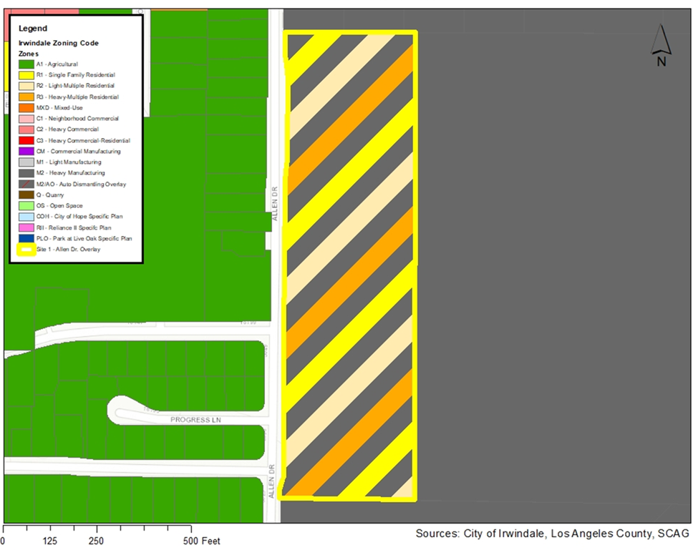
Housing Site 1: Allen Drive

Slide 28
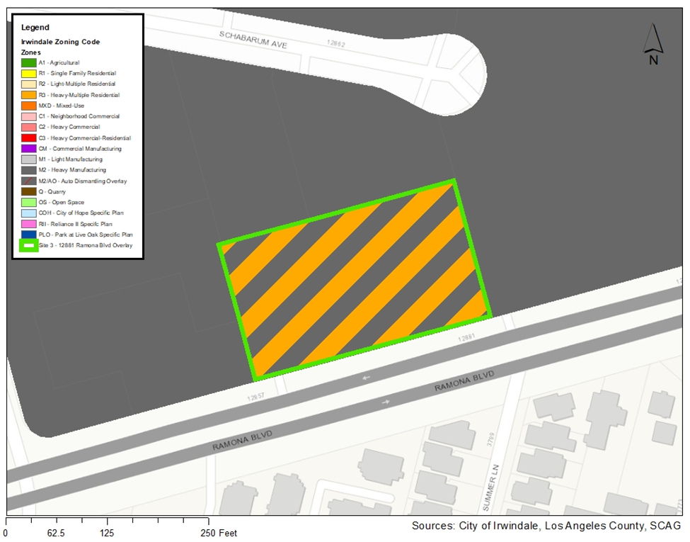
Housing Site 2: 12881 Ramona Blvd.

Slide 29
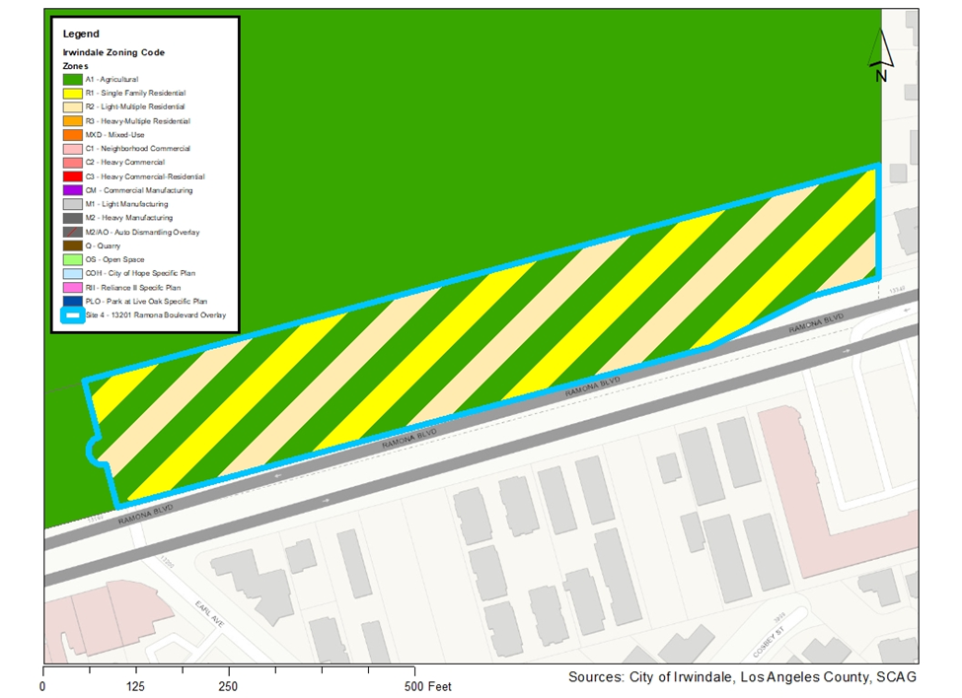
Housing Site 3: 13201 Ramona Blvd.

Slide 30
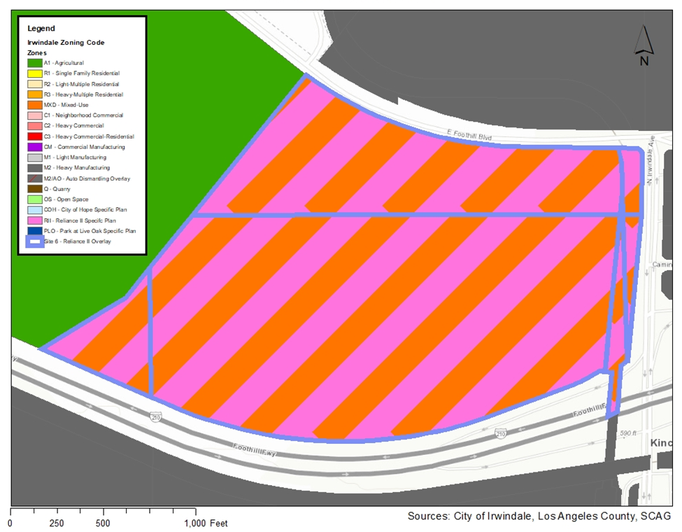
Housing Site 4: Gold Line/
Reliance II

Slide 31
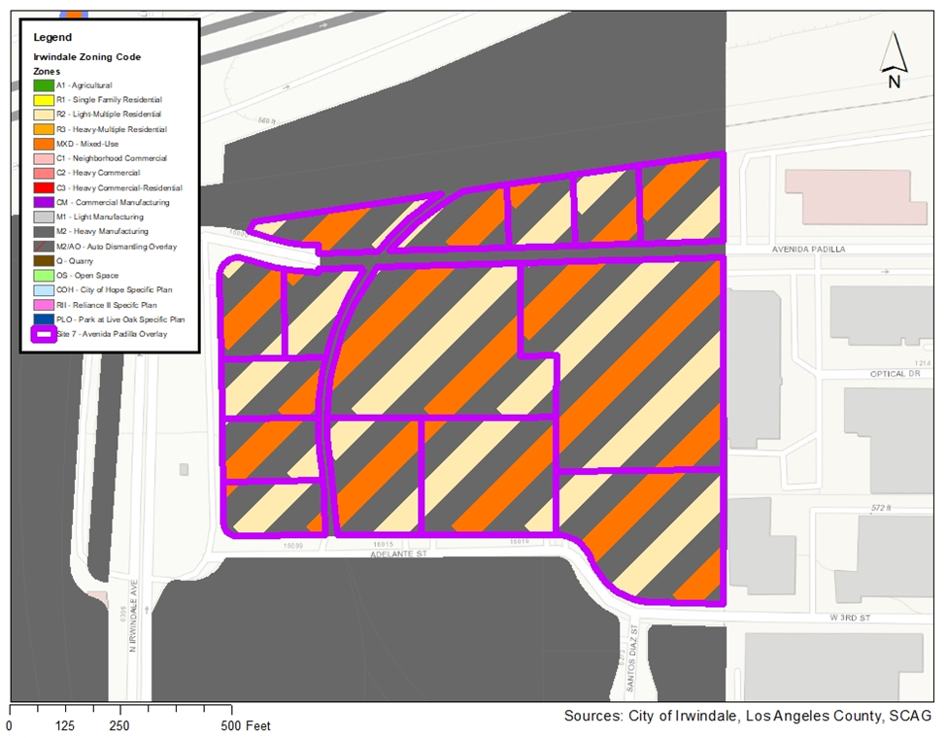
Housing Site 5: Irwindale/ Avenida Padilla

Slide 32
Proposed Housing Programs

Slide 33
Proposed Housing Element Programs
Policy 1: Maintain Existing Housing Quality and Affordability
Program 1: Proactive Residential Code Enforcement (New)
Program 2: Create a Local Housing Rehabilitation Loan Fund

Slide 34
Proposed Housing Element Programs
Policy 2: Remove Governmental Constraints
Program 3: CEQA Exemptions for Infill Projects (New)
Program 4: Facilitate Adaptive Reuse of Commercial/Industrial Projects Near Transit (New)
Program 5: Efficient Project Review (New)
Program 6: Zoning Code Amendments to Comply with State Law (New)
Program 7: Mixed Use Zoning and Development Standards (New)

Slide 35
Proposed Housing Element Programs
Policy 3: Provide Adequate Housing Sites
Program 8: Rezone Targeted Housing Sites
Program 9: Monitor Housing Sites for No Net Loss (New)
Program 10: Arrow Highway Commercial Corridor Specific Plan (New)
Program 11: General Plan Consistency
Program 12: Facilitate Housing Development on Large Sites (New)

Slide 36
Proposed Housing Element Programs
Policy 4: Provide New Affordable Housing
Program 13: Leverage Allen Drive Site for Affordable Housing
Program 14: Create an Affordable Housing Linkage Fee Program (New)
Program 15: Tenant-Based Rental Assistance
Program 16: Affordable ADU Incentive Program
Program 17: ADU Design Templates and Monitoring (New)
Program 18: State Action Ordinances (New)

Slide 37
Proposed Housing Element Programs
Policy 5: Affirmatively Further Fair Housing and Address Special Housing
Needs
Program 19: Senior Housing Opportunities (New)
Program 20: Housing Opportunities for People with Disabilities (New)
Program 21: Fair Housing Program/Outreach
Program 22: Provide Streamlined Approvals for Affordable Housing (New)
Program 23: Workforce Housing Development (New)
Program 24: Affordable Housing Development Assistance and Implementation Guide
(New)
Program 25: Provide Reasonable Accommodations
Program 26: Homeless Service Strategy (New)

Slide 38
Proposed Housing Element Programs
Policy 6: Promote Sustainability, Energy Efficiency, and a Healthy
Community
Program 27: Grants for Green Appliances, Solar, Sustainability/Energy Efficiency
Program 28: Promote Sustainable Community Design (New)
Program 29: Bi-Annual Trash and Hazardous Item Pick-Up (New)

Slide 39
Community Input
Questions/Input on Housing Programs
Questions/Input on Housing Sites
Questions/Input on Other Aspects of the Housing Element
Please e-mail or send written comments to:
Marilyn Simpson, Community Development Department (msimpson@irwindaleca.gov)
5050 N. Irwindale Avenue, Irwindale, CA 91706

Slide 40
Additional Comments Will Be Accepted By No Later than December 21, 2022
Please e-mail or send written comments on the Draft Housing Element to:
Marilyn Simpson
Community Development Department
msimpson@irwindaleca.gov
5050 N. Irwindale Avenue
Irwindale, CA 91706

Slide 41
Next Steps for Housing Element Update
Planning Commission Meeting to Review Draft HE (12/21/22)
Prepare Revised Draft Housing Element for CA HCD review
Revise Draft Housing Element in Response to HCD comments
Adopt Final Housing Element
Submit adopted Housing Element to HCD for review
Housing Element certification
Public Input

